Slide 1
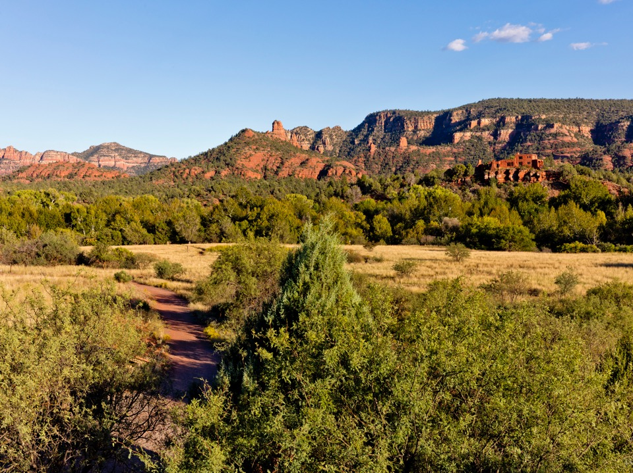


Arizona State Parks Board
June 17, 2021
Dale Larsen – Chair
John Sefton – Vice Chair, Lisa Atkins, Jeffrey Buchanan, Debbie Johnson, Terri Palmberg

Slide 2
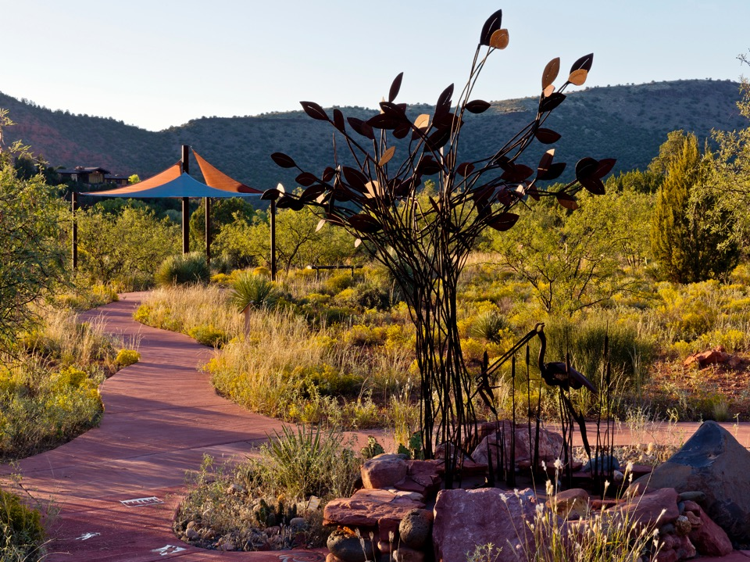
AGENDA – A
Call to Order

Slide 3

AGENDA – B
Pledge of Allegiance

Slide 4
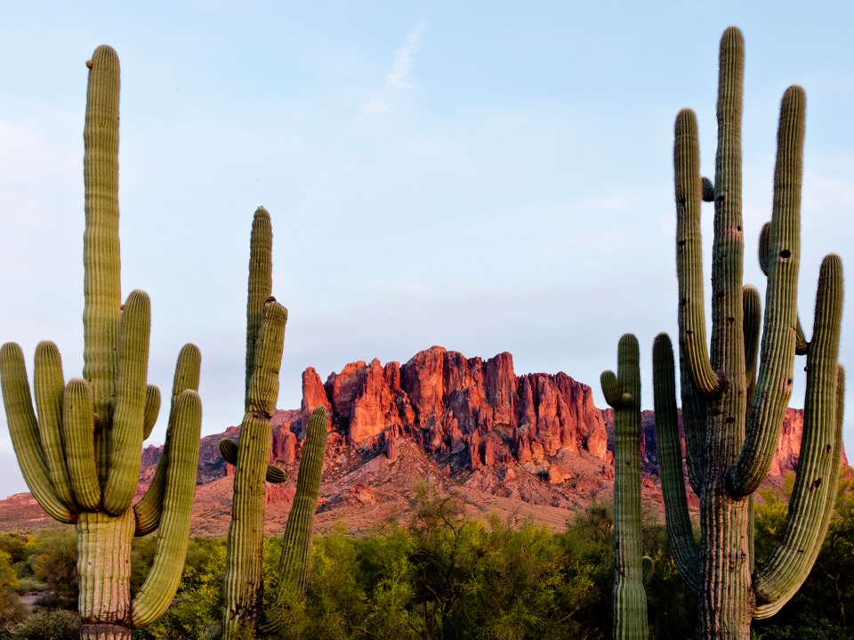
AGENDA – C
Member Roll Call
Dale Larsen (Chair)
John Sefton (Vice-Chair)
Lisa Atkins
Jeffrey Buchanan
Debbie Johnson
Terri Palmberg

Slide 5
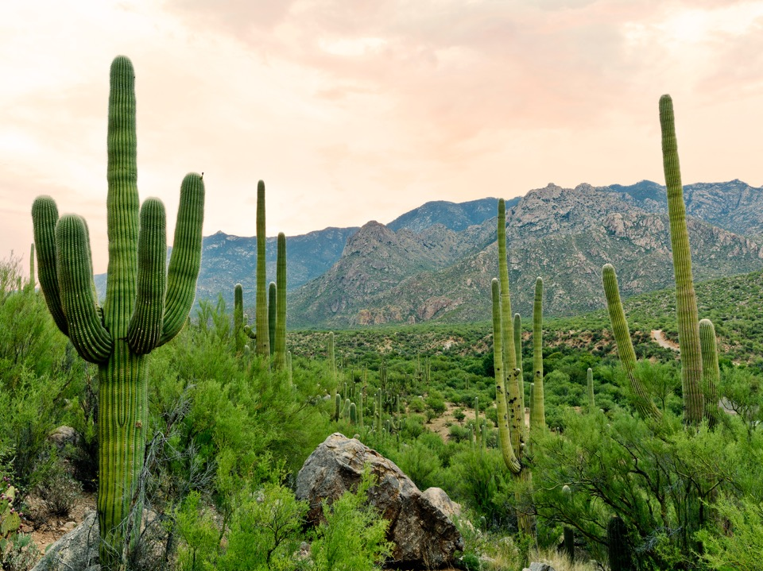
AGENDA – C
Mission Statement
“As Board members we are gathered today to be the stewards and voice of the Arizona State Parks and its Mission Statement to manage and conserve Arizona’s natural, cultural and recreation resources for the benefit of the people, both in our parks and through our partners.”

Slide 6
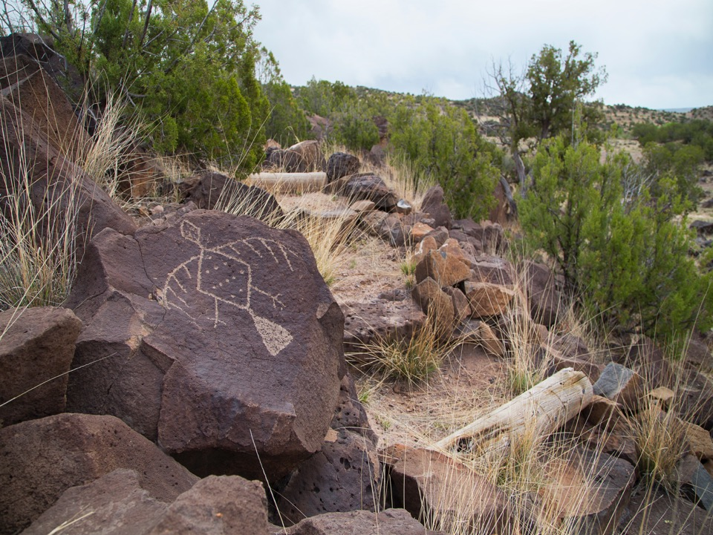
AGENDA – D1
Approval of Minutes
The Board will review and may consider action to approve the meeting minutes from May 20, 2021.

Slide 7
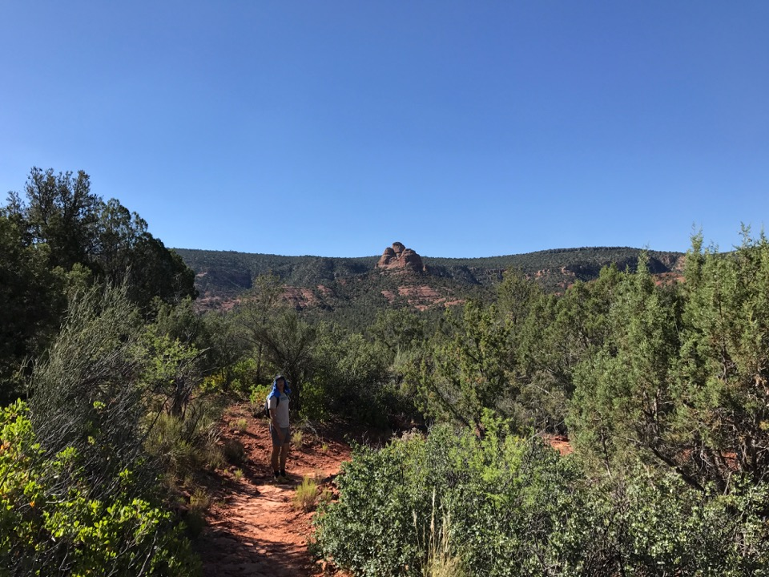
AGENDA – D1
Motion:
I move to approve the meeting minutes from May 20, 2021.

Slide 8
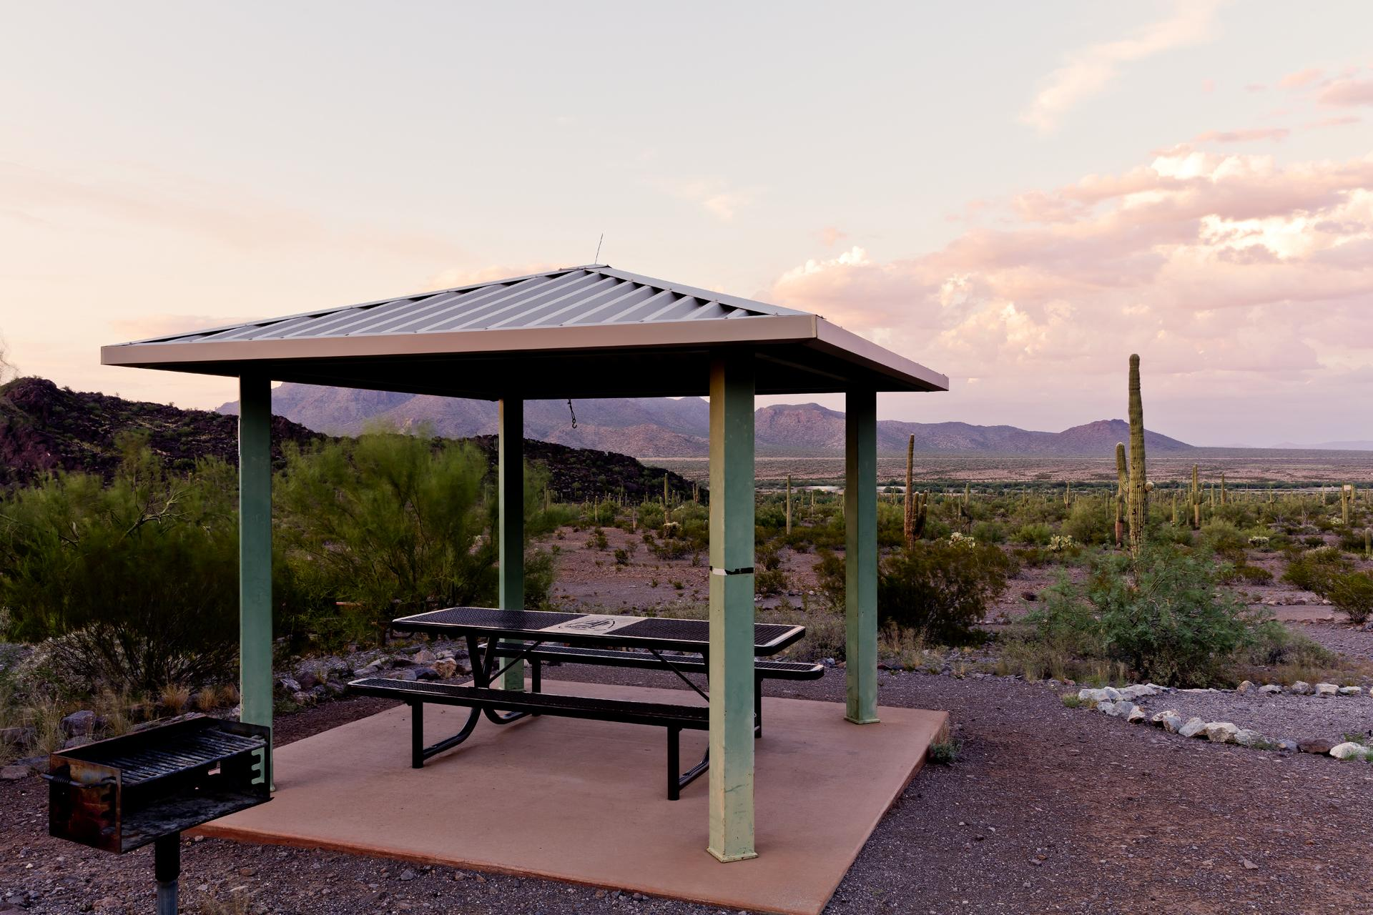
AGENDA – D2
2021 Recreational Trails Program Non-Motorized Grant Applications
-Mickey Rogers, Chief of Grants and Trails.

Slide 9
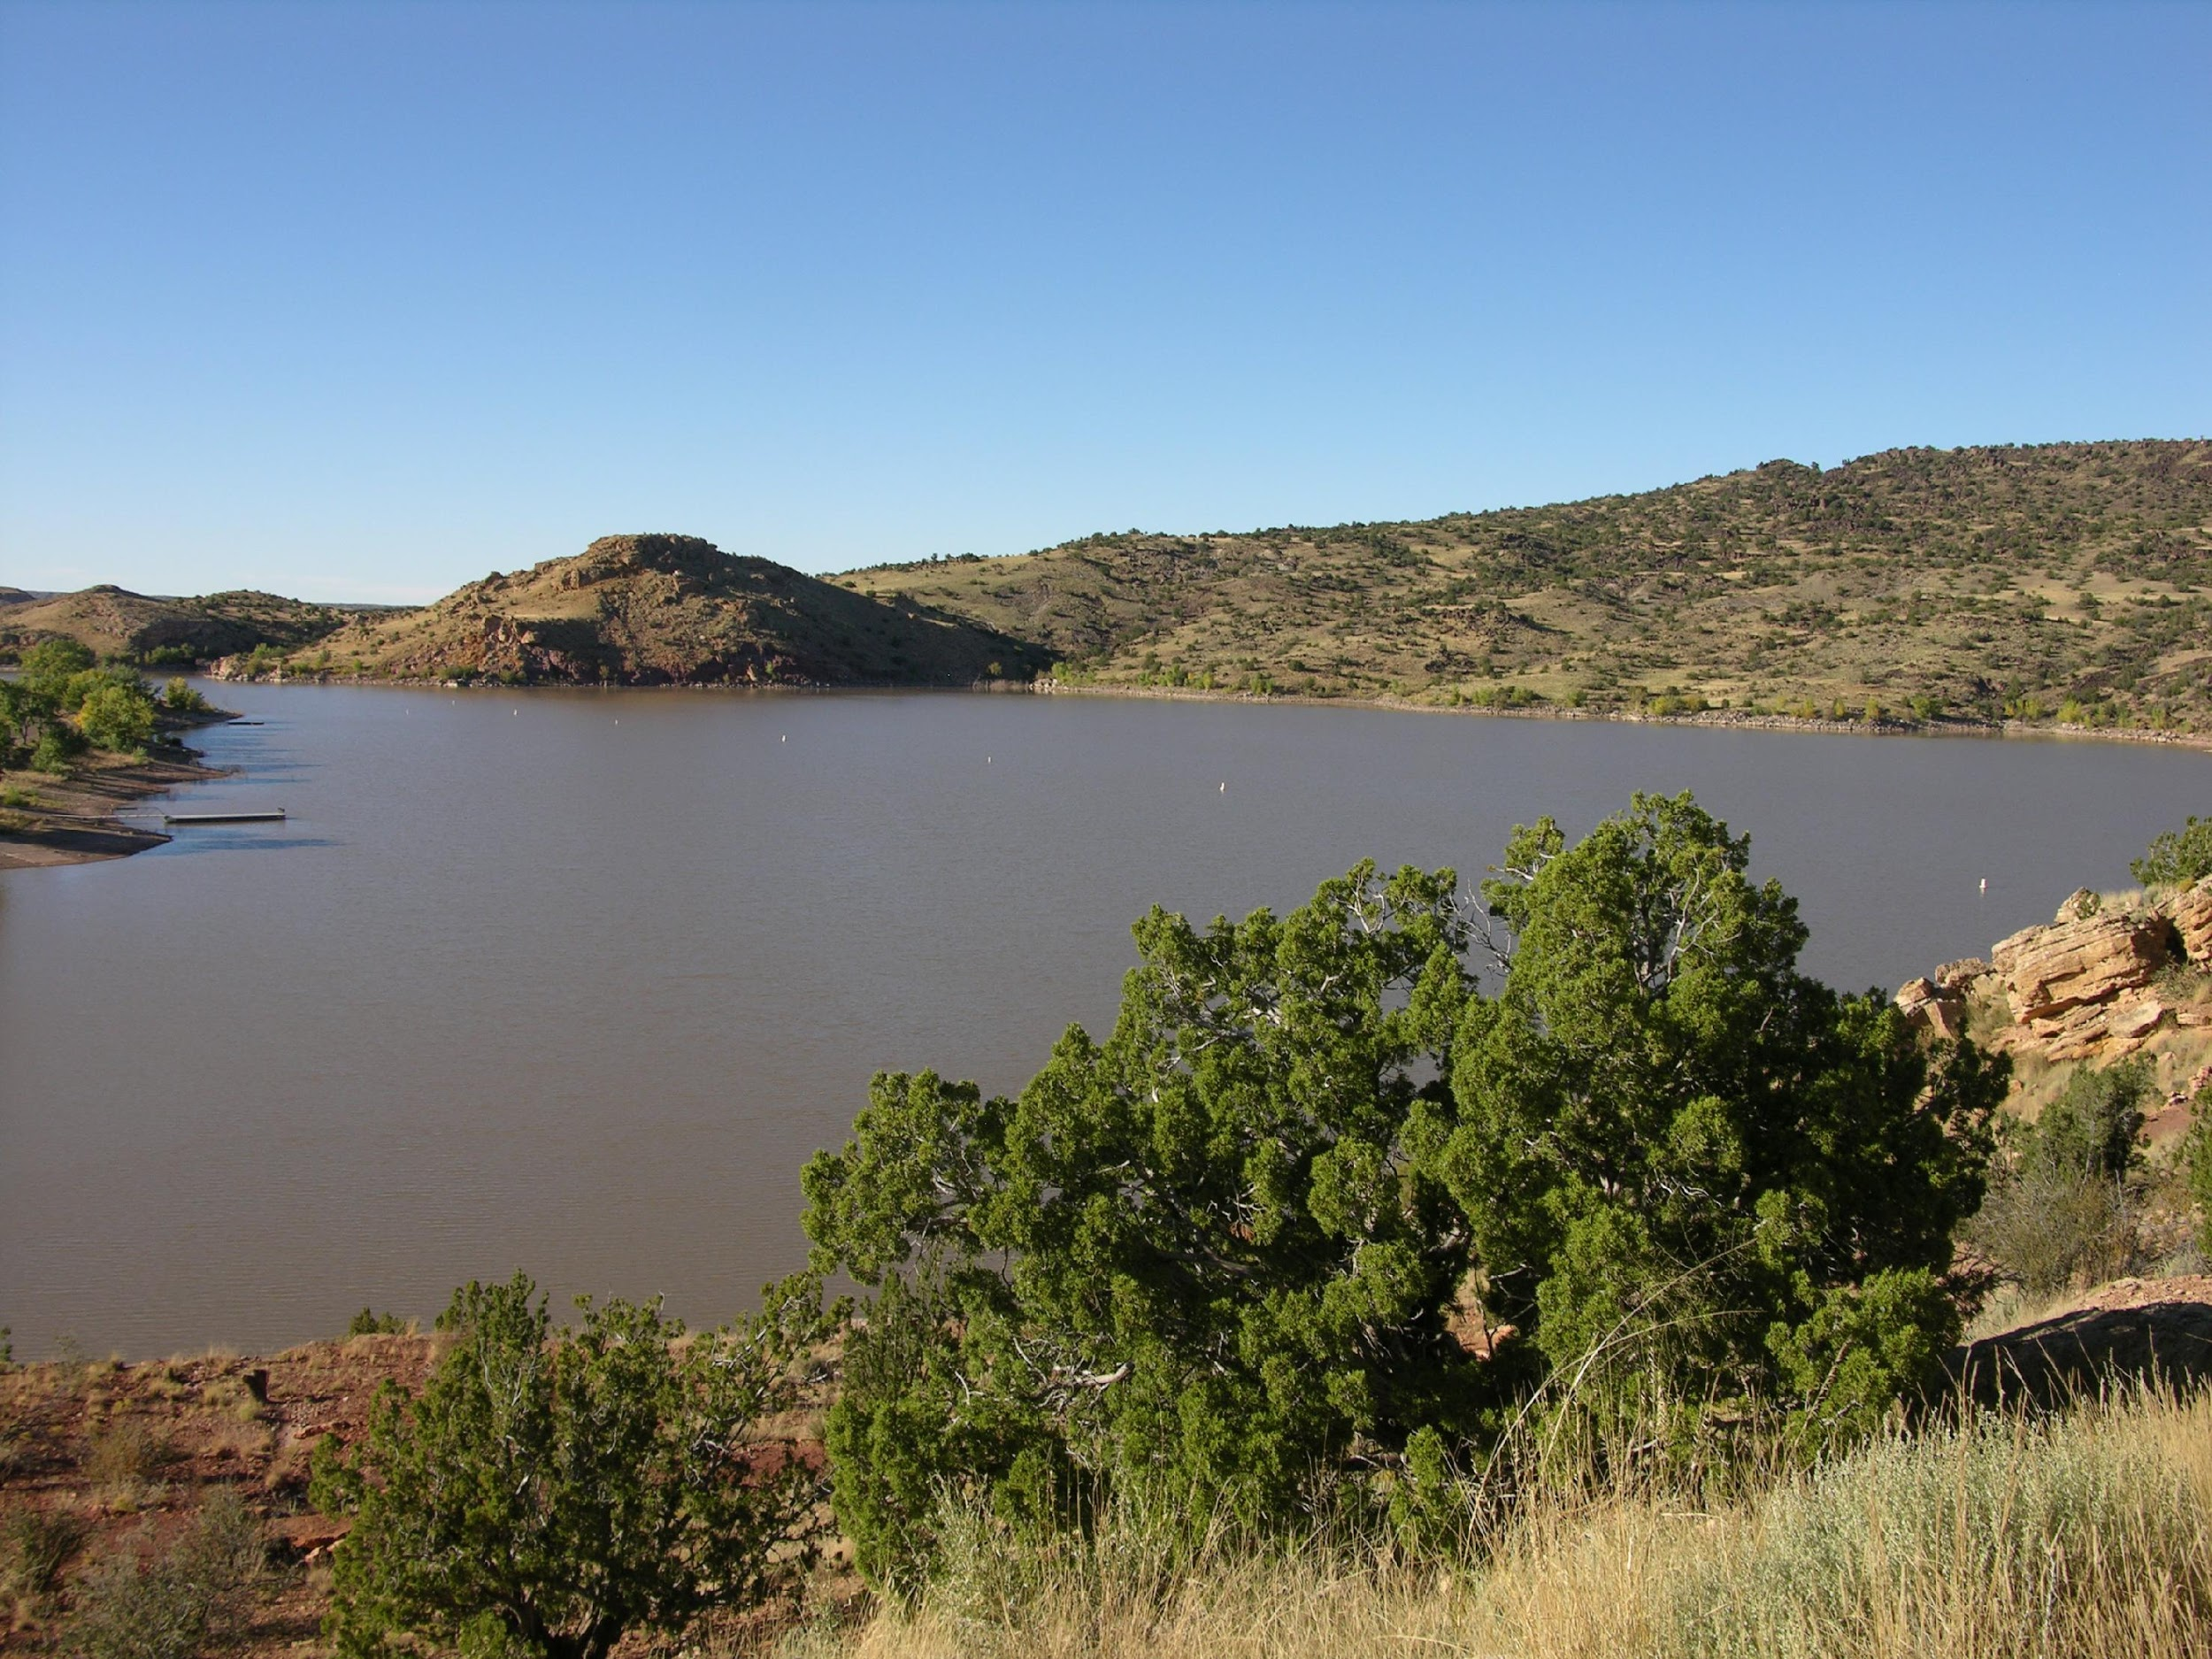
AGENDA – D2
2021 Recreational Trails Program Non-Motorized Fund Grant Applications
Sponsor | Project | Request | Staff/Arizona State Committee On Trails (ASCOT) Recommendations/Arizona Outdoor Recreation Coordinating Committee (AORCC) | Score
Verde Valley Archaeology Center | Native American Heritage Trail Improvements | $150,000.00 | $150,000.00 | 19.0
Arizona Historical Society | Pioneer Museum ADA Trail | $70,058.00 | $70,058.00 | 18.7
Total |  | $220,058.00 | $220,058.00

Slide 10
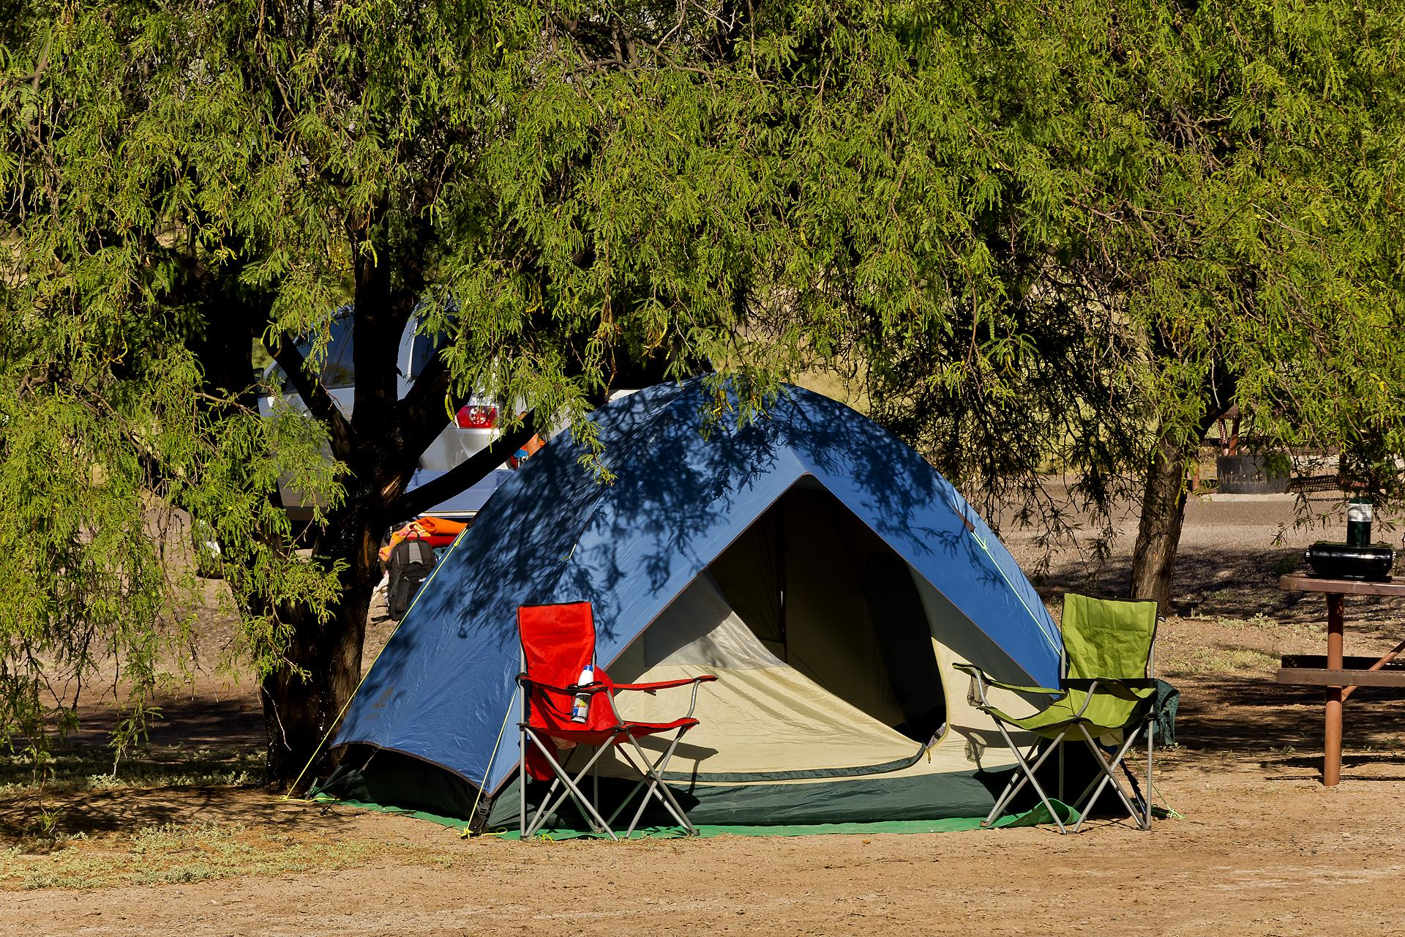
AGENDA – D2
Motion:
I move to approve funding for the submitted 2021 Non-Motorized grant applications as follows: Verde Valley Archaeology Center, Native American Heritage Trail Improvements in the amount of _______ and the Arizona Historical Society Pioneer Museum ADA Trail in the amount of _________.

Slide 11
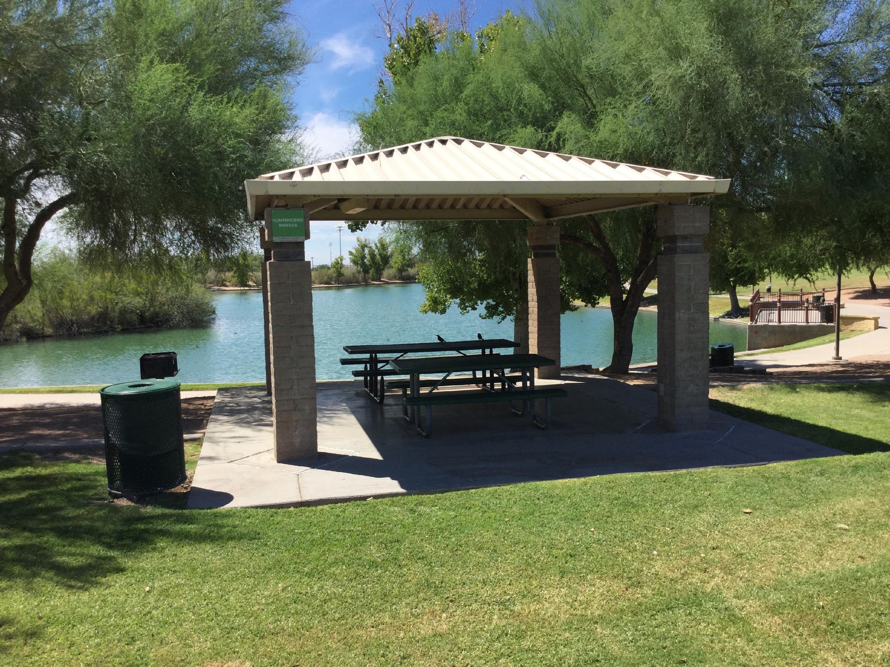
AGENDA – D3
2021 Recreational Trails Program Safety and Environmental Education (SEE) Grant Applications
-Mickey Rogers, Chief of Grants and Trails.

Slide 12
AGENDA – D3
2021 Recreational Trails Program Safety and Education Grant Applications
Sponsor | Project | Request | Staff/ ASCOT/AORCC Recommendations
Tucson Audubon Society | Cuckoo Corridor Trail Signage | $3,185.00 | $3,185.00
Legends of Superior Trails | LOST Trailer, Tools and Training | $7,498.00 | $7,498.00
Total |  | $10,683.00 | $10,683.00

Slide 13
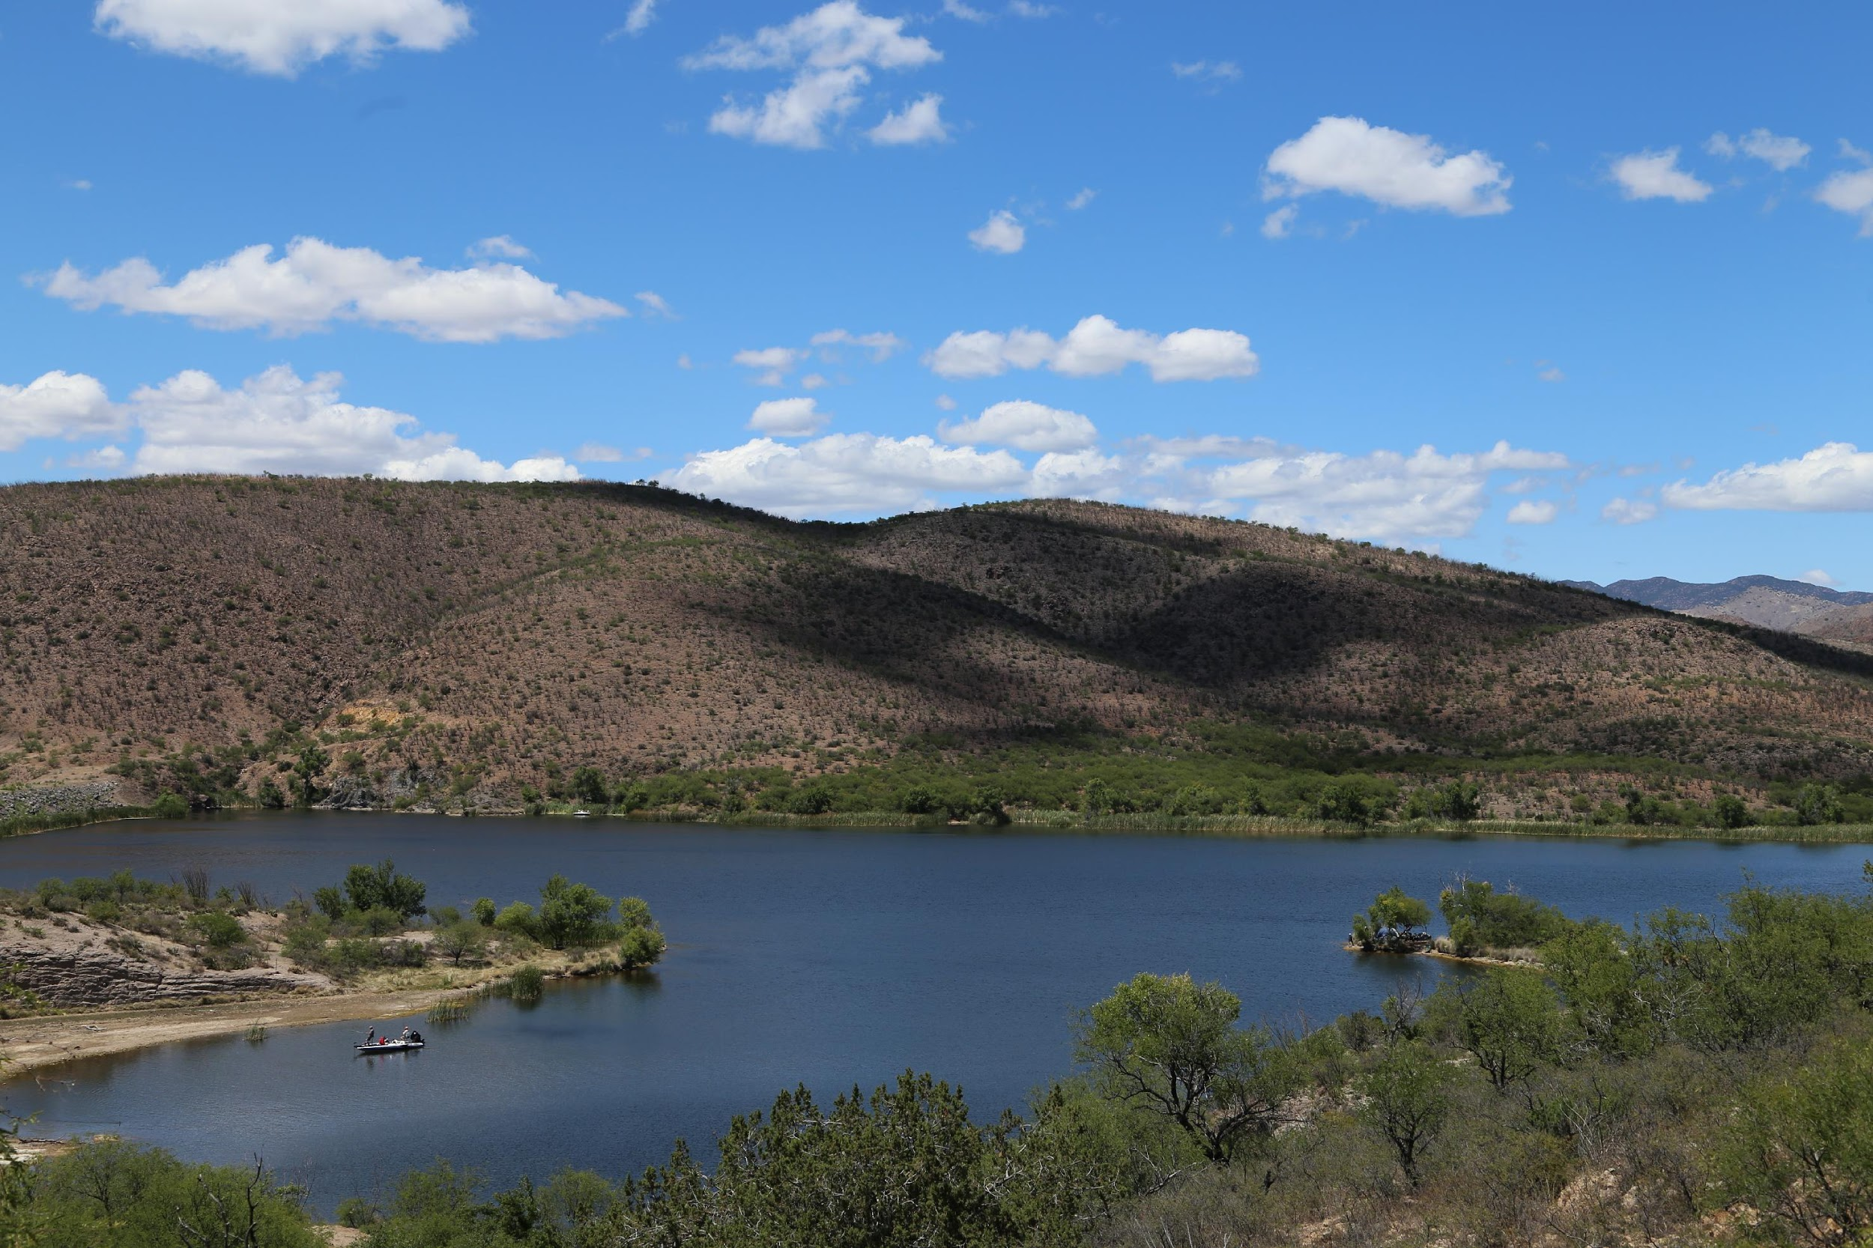
AGENDA – D3
Motion:
I move to approve funding for the submitted 2021 Recreational Trails Program Safety and Environmental Education grant applications as follows: Tucson Audubon Society, Cuckoo Corridor Trail Signage in the amount of _______, and Legends of Superior Trails, LOST Trailer, Tools and Training in the amount of _______.

Slide 14
AGENDA – D4
2021 Land and Water Conservation Fund Grant Applications.
-Mickey Rogers, Chief of Grants and Trails.

Slide 15
AGENDA – D4
2021 Land and Water Conservation Fund Grant Applications
Sponsor | Project | Request | Staff | Score
City of Wilcox | Keiller Park and Quail Drive Sports Complex Development and Enhancement | $2,165,041.00 | $1,500,000.00 | 76.75
Yuma County | Foothills Park | $584,433.00 | $584,433.00 | 63.25
City of Sierra Vista | Veteran’s Memorial Park and Sports Complex Irrigation Replacement | $1,500,000.00 | $1,500,000 | 66.0
City of Apache Junction | Superstition Shadows Renovations and Updates | $521,161.00 | $521,161.00 | 71.0
Kartchner Caverns State Park | Park Improvement Project | $404,951.00 | $404,951.00 | 61.5
City of Nogales | Teyechea City Park Renovation | $809,907.00 | $809,907.00 | 59.5
Total |  | $5,985,493.00 | $5,320,452.00

Slide 16
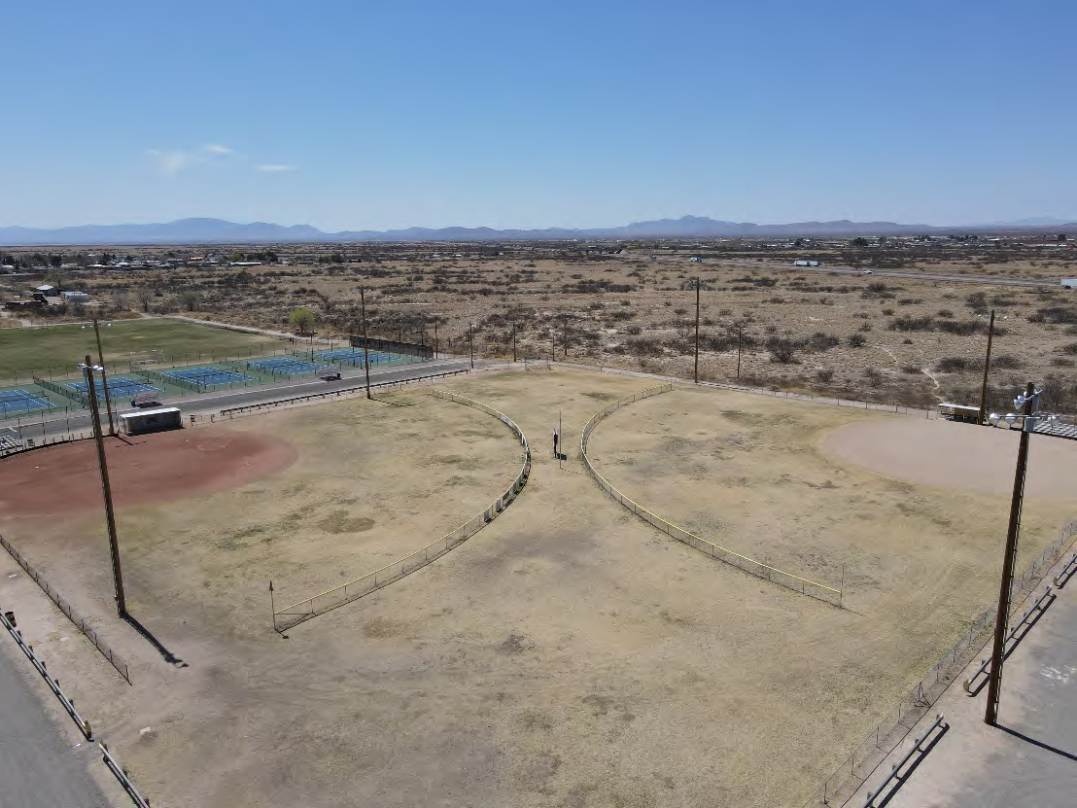
AGENDA – D4
Notes:
Wilcox

Slide 17
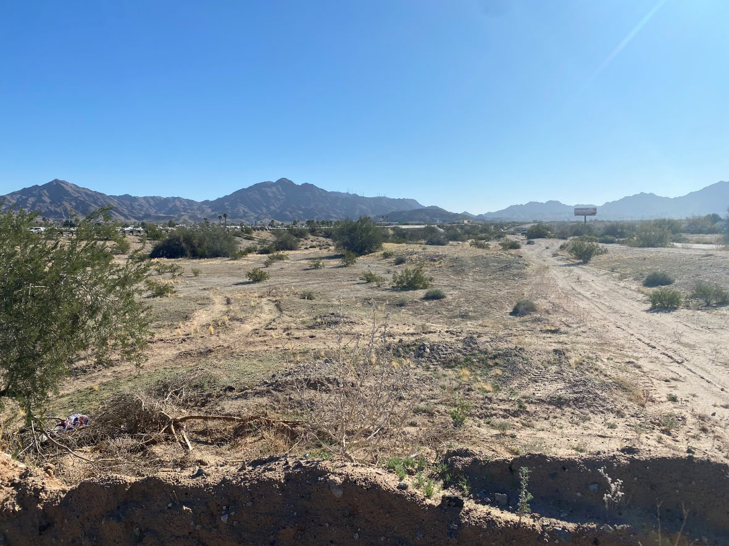
AGENDA – D4
Notes:
Yuma County

Slide 18
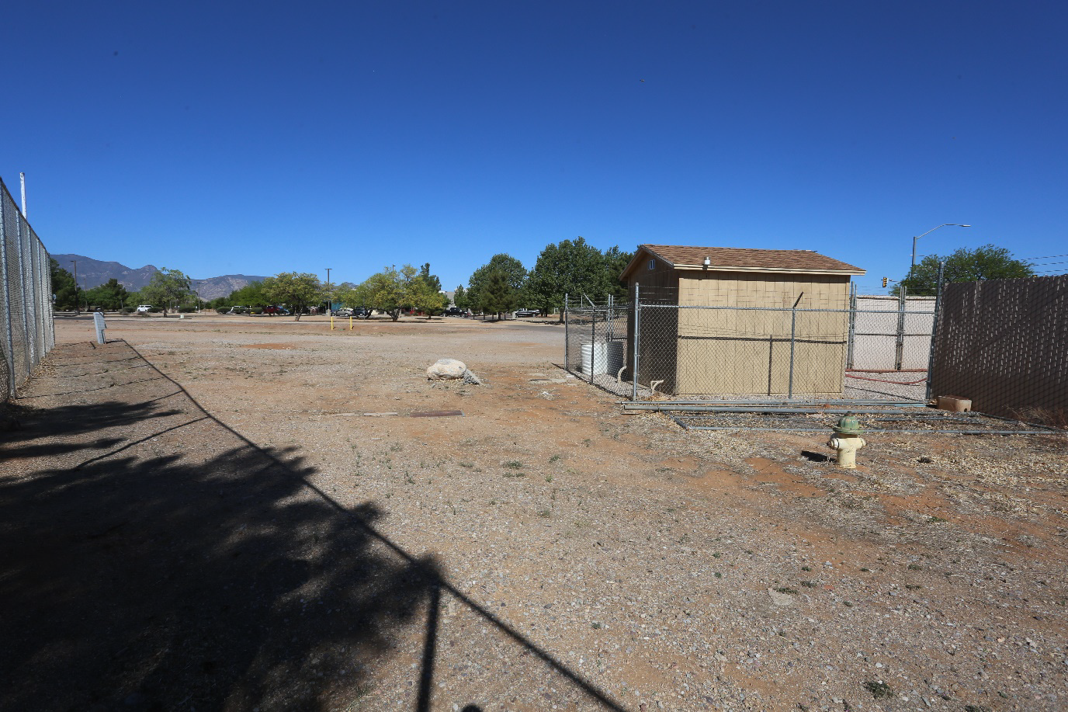
AGENDA – D4
Notes:
Sierra Vista

Slide 19
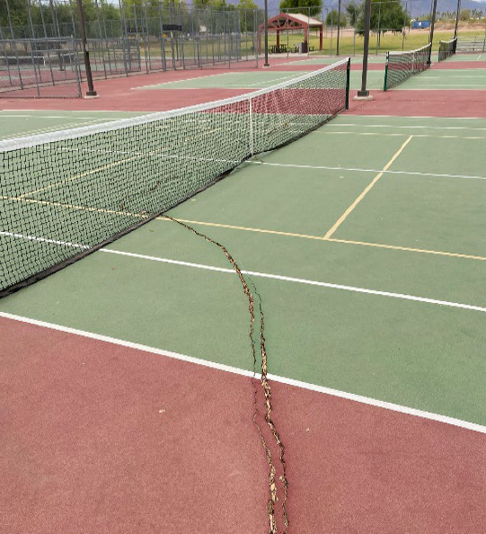
AGENDA – D4
Notes:
apache junction

Slide 20
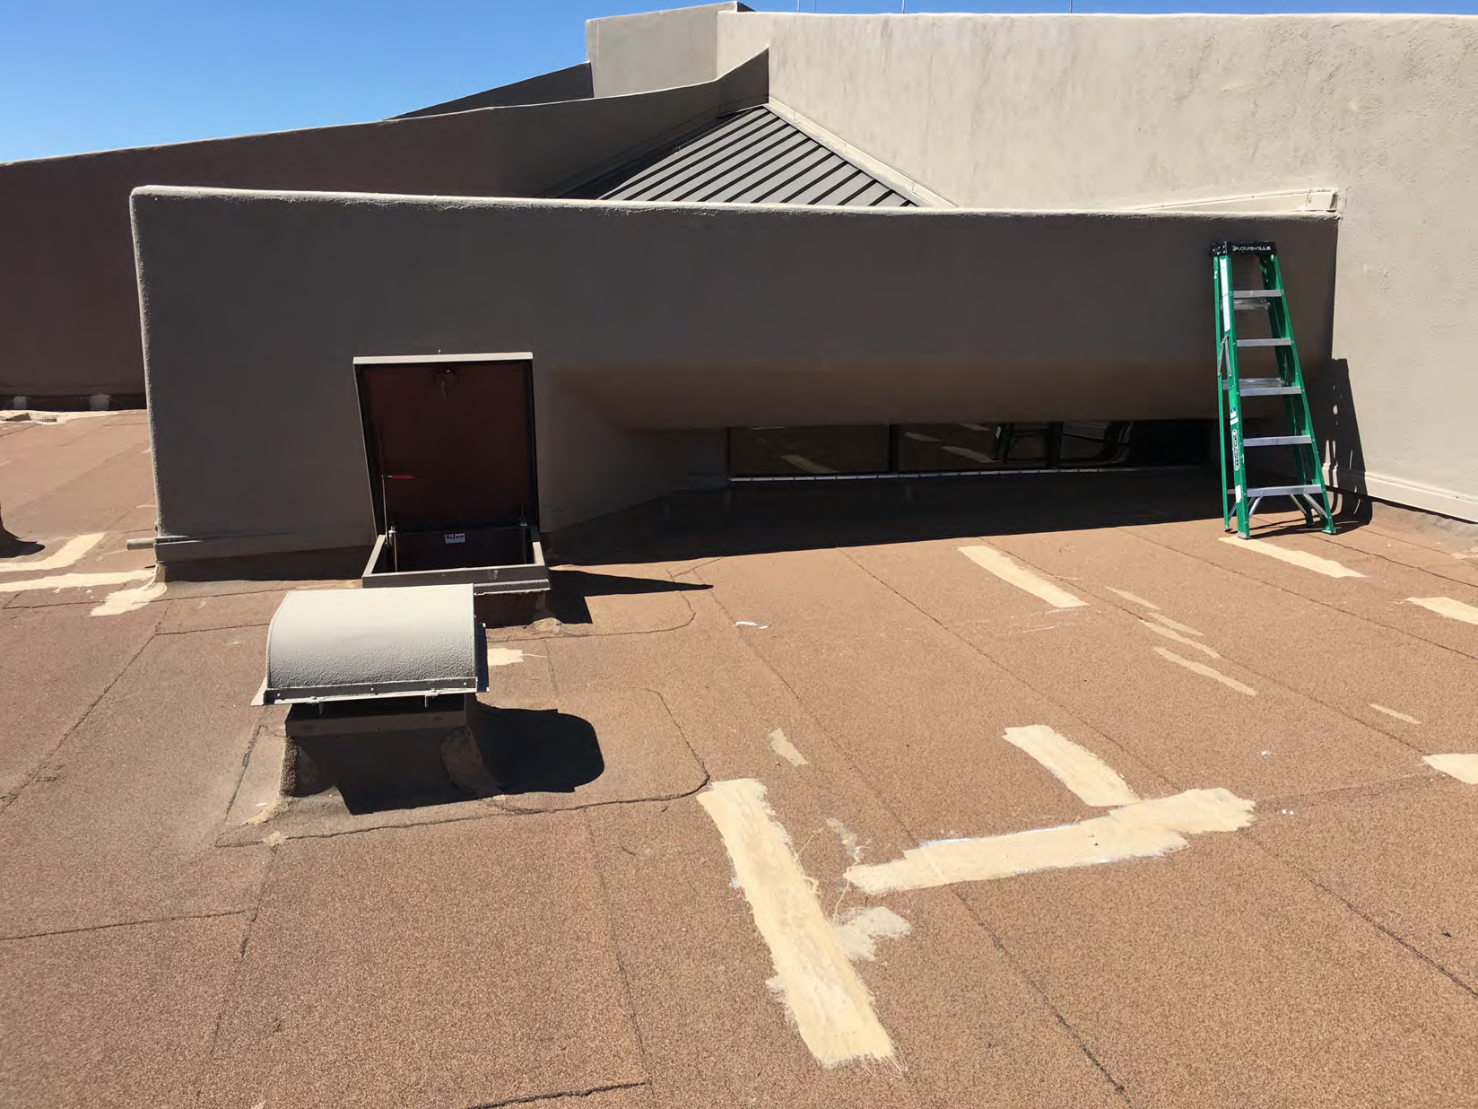
AGENDA – D4
Notes:
Kartchner Caverns

Slide 21
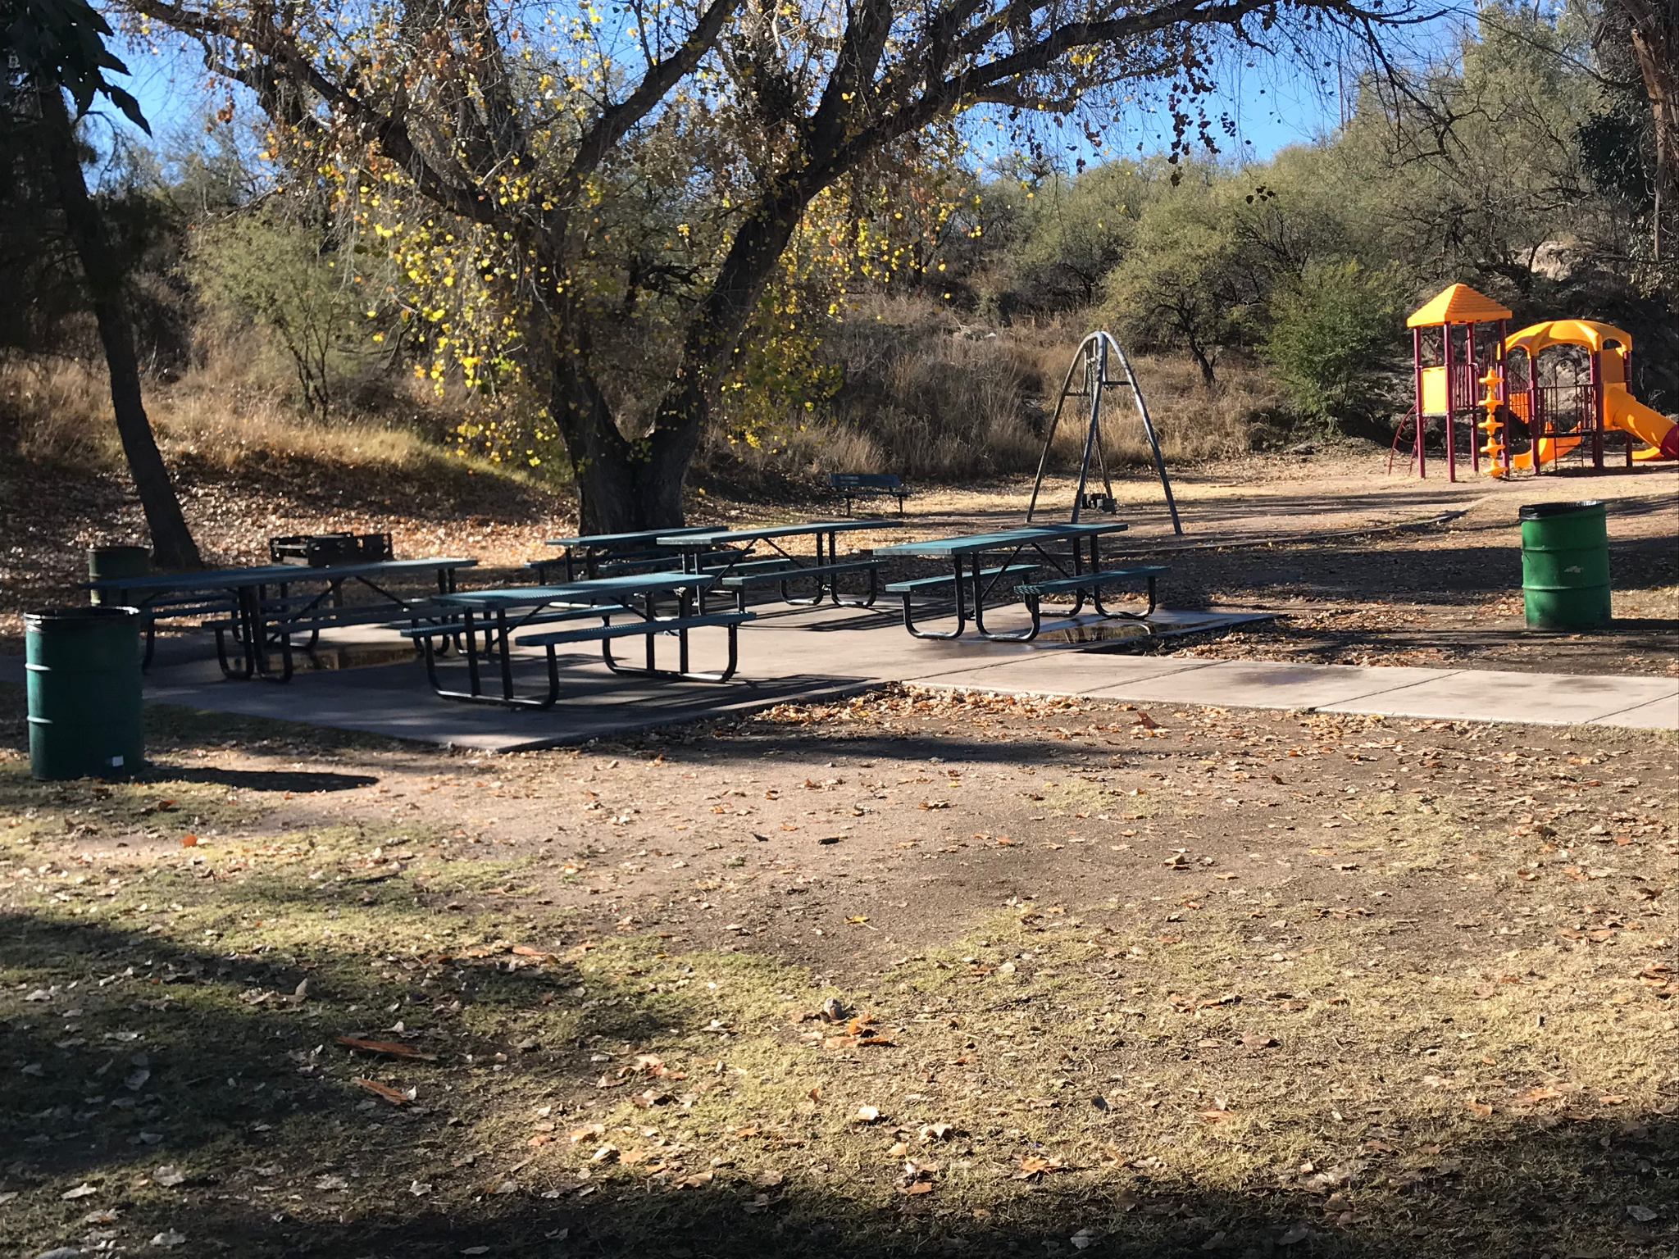
AGENDA – D4
Notes:
Nogales

Slide 22
AGENDA – D4
Motion:
I move to approve funding for the submitted 2021 Land and Water Conservation Fund grant applications as follows: Wilcox’s Keiller Park and Quail Sports Complex in the amount of ____, Yuma County Foothills Park in the amount of ____, Apache Junction’s Superstition Shadows Renovation in the amount of ____, Kartchner Caverns State Park Improvement Project in the amount of ____, and Nogales Teyeschea City Park Renovation in the amount of _______.

Slide 23
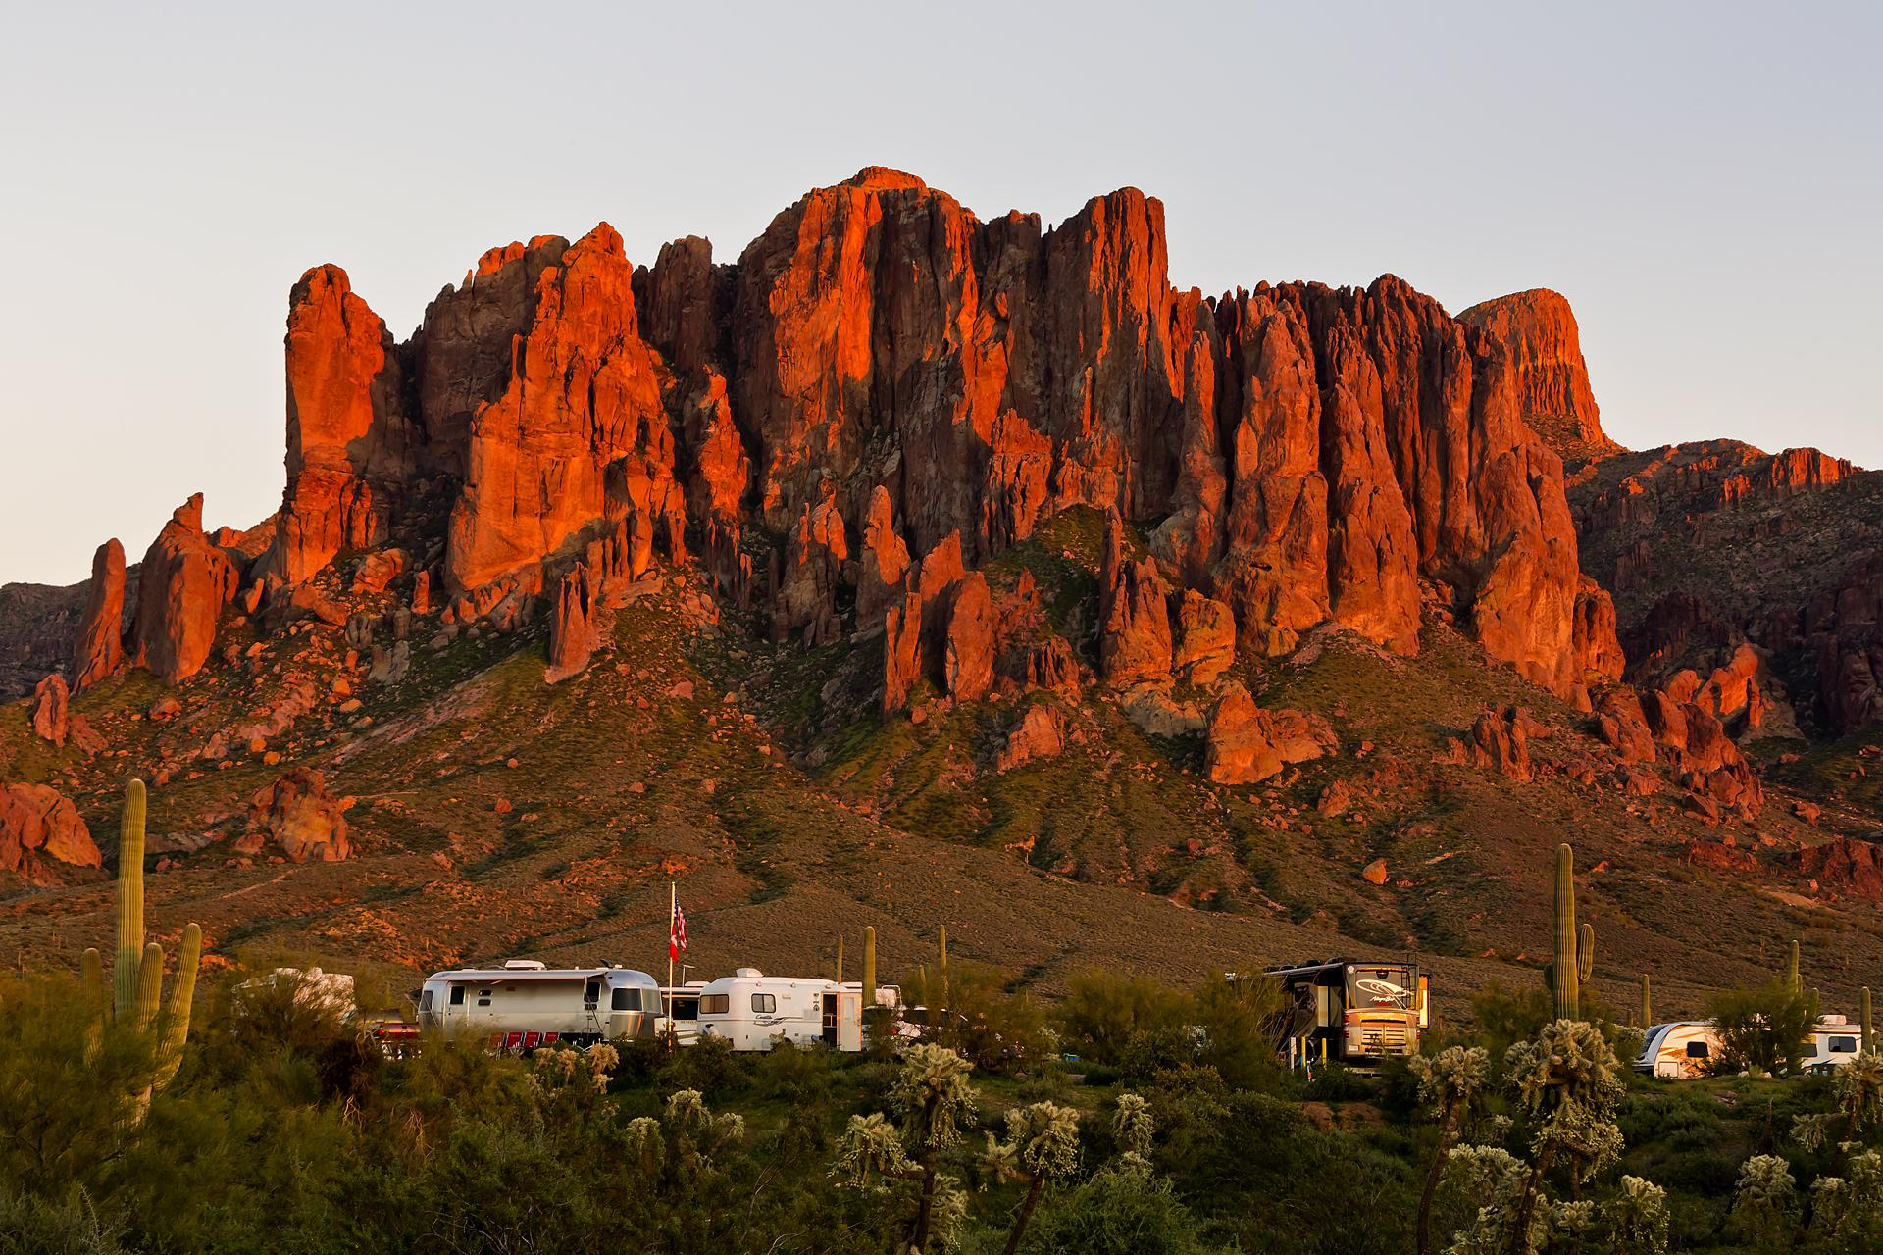

AGENDA – D5
LWCF Project Amendment
-Mickey Rogers, Chief of Grants and Trails.

Slide 24
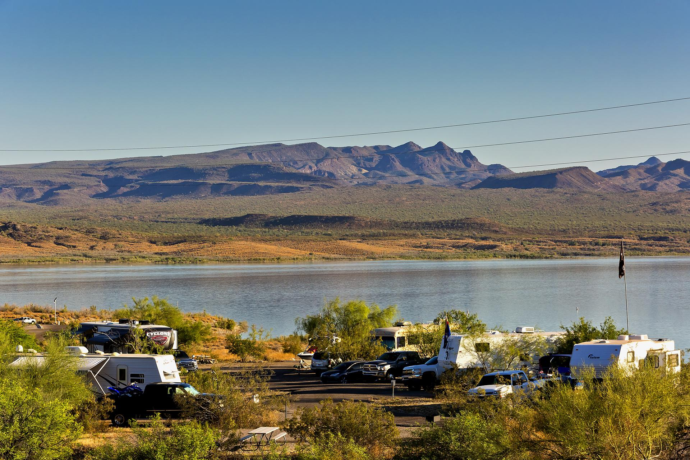
AGENDA – D5
Arizona State Parks and Trails Amendment Request, Red Rock State Park Water Tower and Maintenance Building
Original Award | Amendment Increase Request | New Award | Staff Recommendation/AORCC
$343,600.00 | $9,650.00 | $353,250.00 | Increase $9,650.00

Slide 25
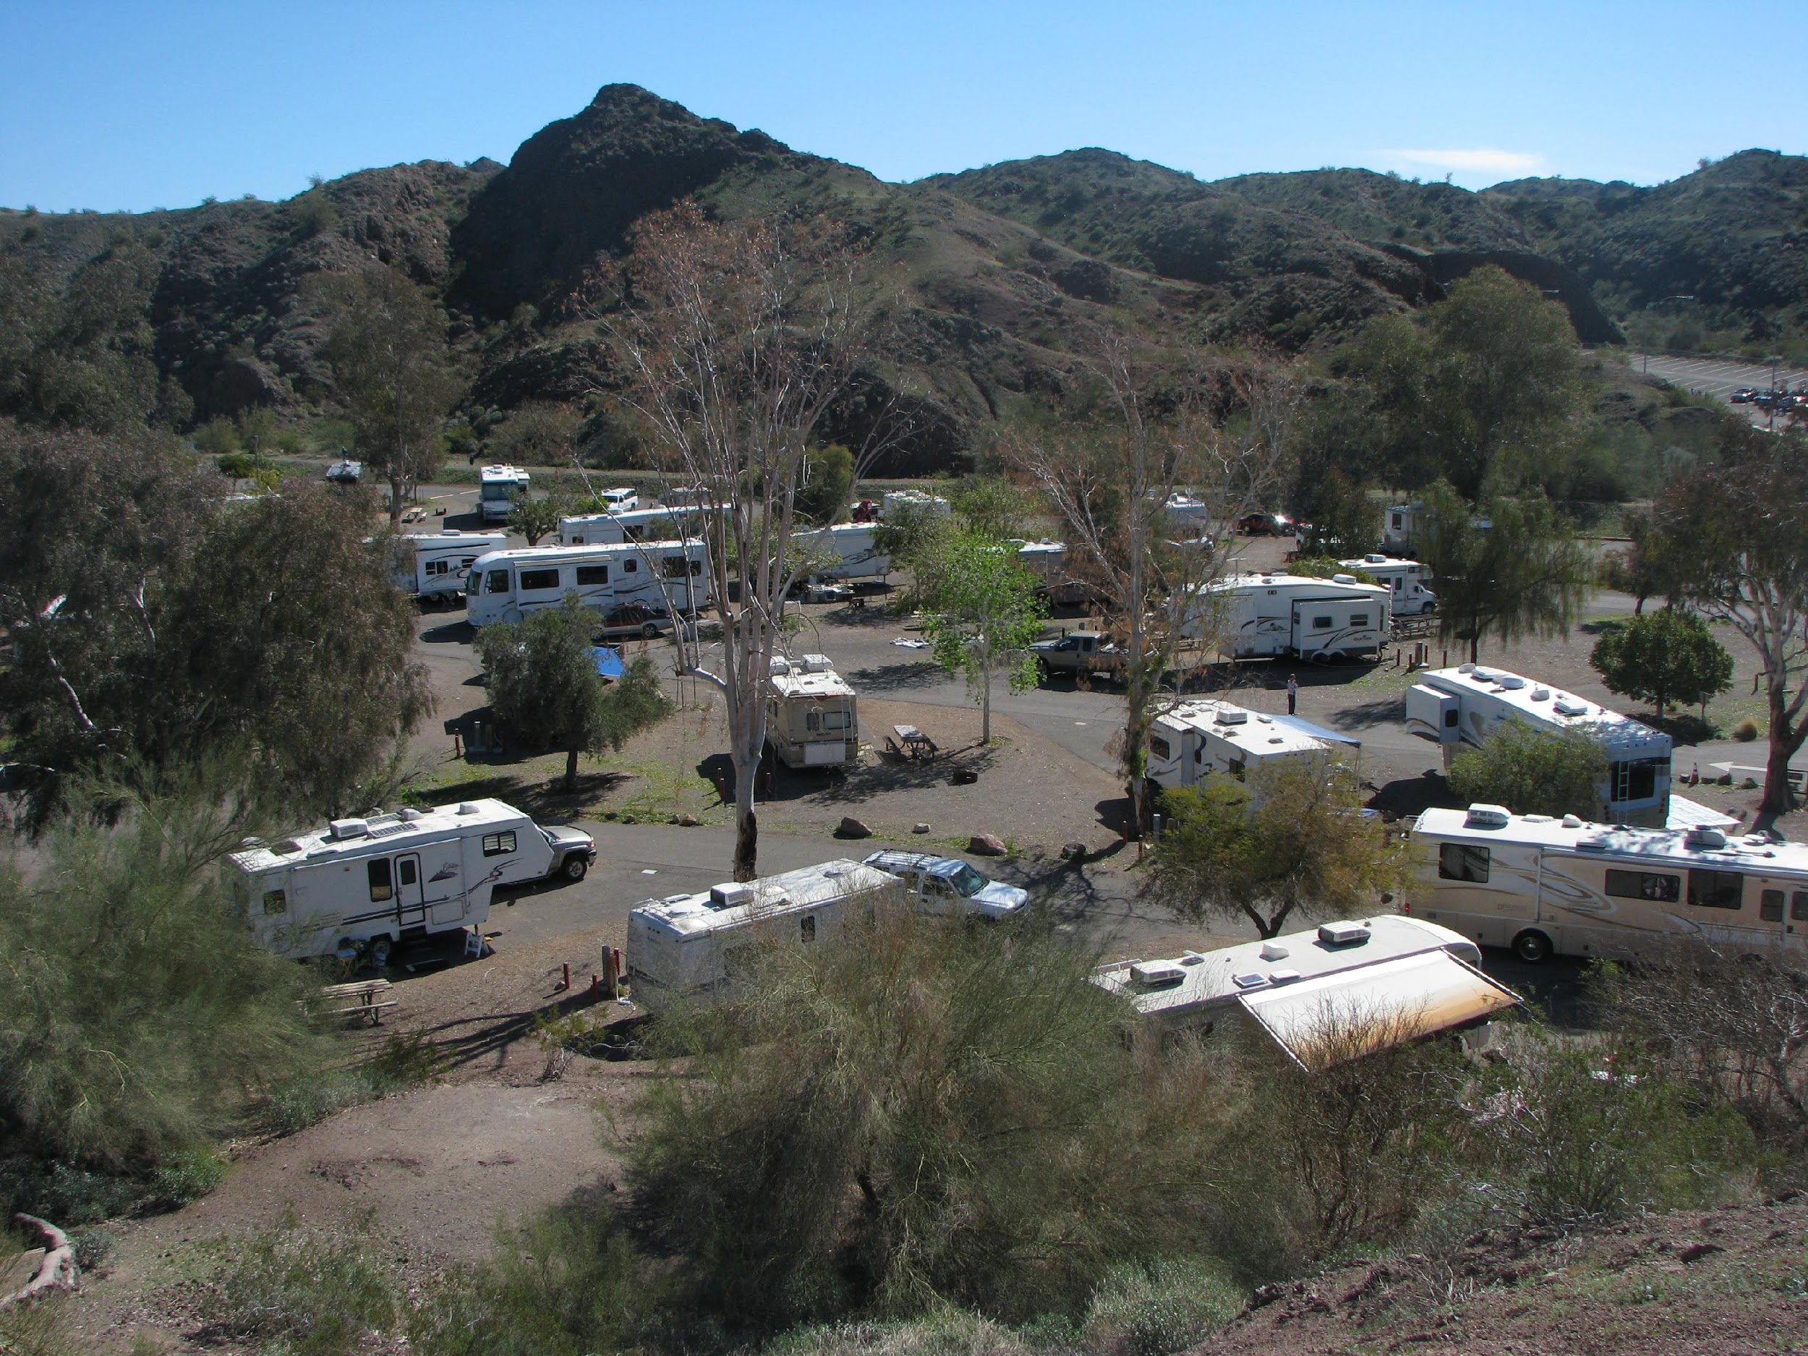
AGENDA – D5
Motion:
I move to approve an amendment to increase the LWCF Award for the approved Red Rock State Park Land and Water Conservation Fund Water Tower/Maintenance Building Project from _______ to _____.

Slide 26
AGENDA – D6
2021 Motorized Grant Applications
-Matt Eberhart, Off-Highway Vehicle Coordinator.

Slide 27
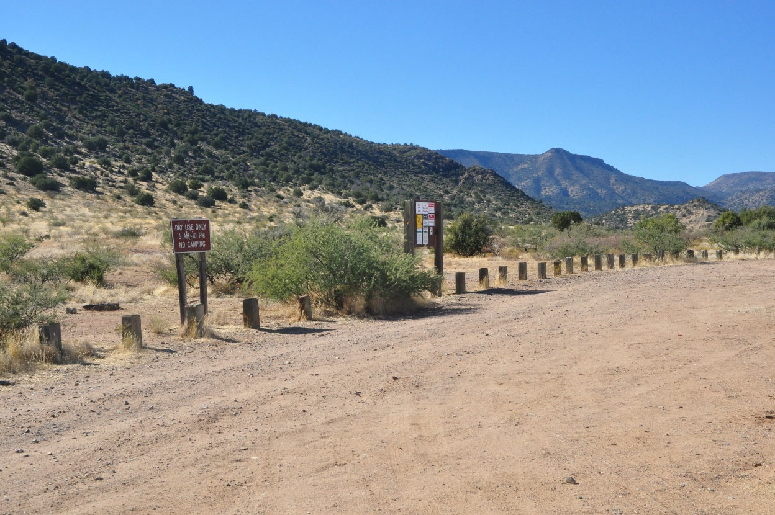
AGENDA – D6
Notes:
Grief Hill Trailhead

Slide 28
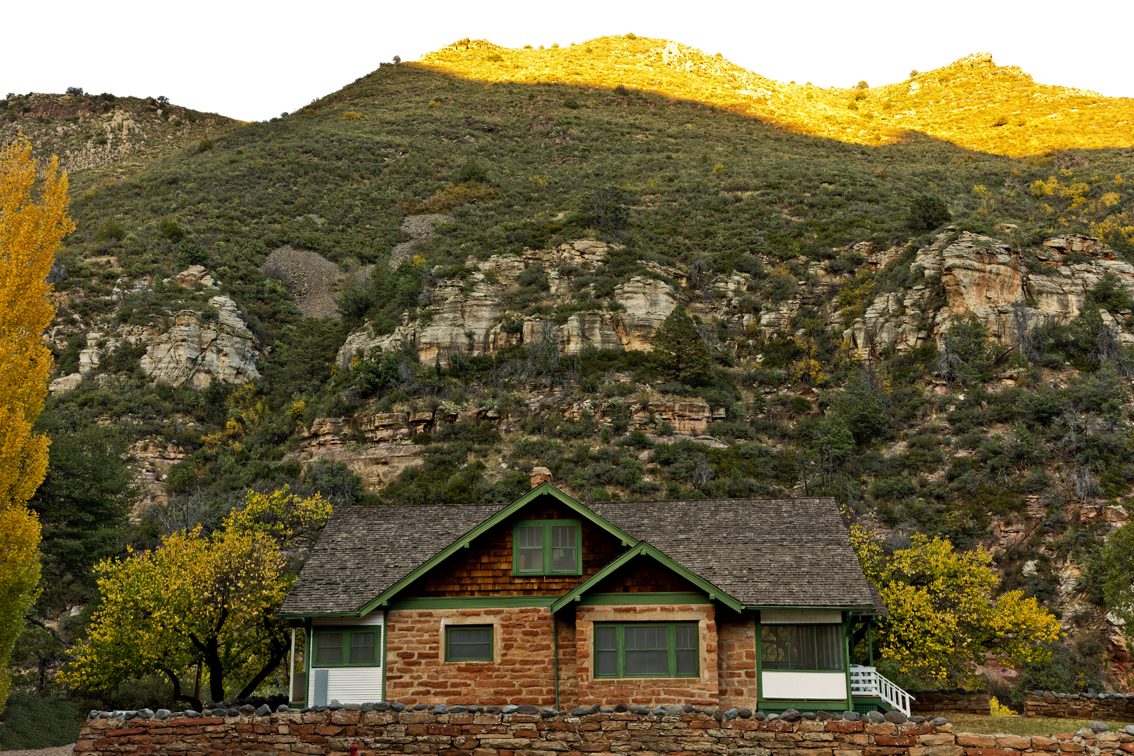
AGENDA – D6
2021 Motorized Grant Application
Sponsor | Project | Request | Recommendations Staff/ Off Highway Vehicle Advisory Group (OHVAG), AORCC | Score
Town of Camp Verde | Grief Hill Trailhead | $220,600.00 | $220,600.00 | 37
TOTAL |  | $220,600.00 | $220,600.00

Slide 29
AGENDA – D6
Motion:
I move approve funding for the 2021 Motorized Grant Applications as follows: the Town of Camp Verde, Greif Hill Trailhead in the amount of _______.

Slide 30
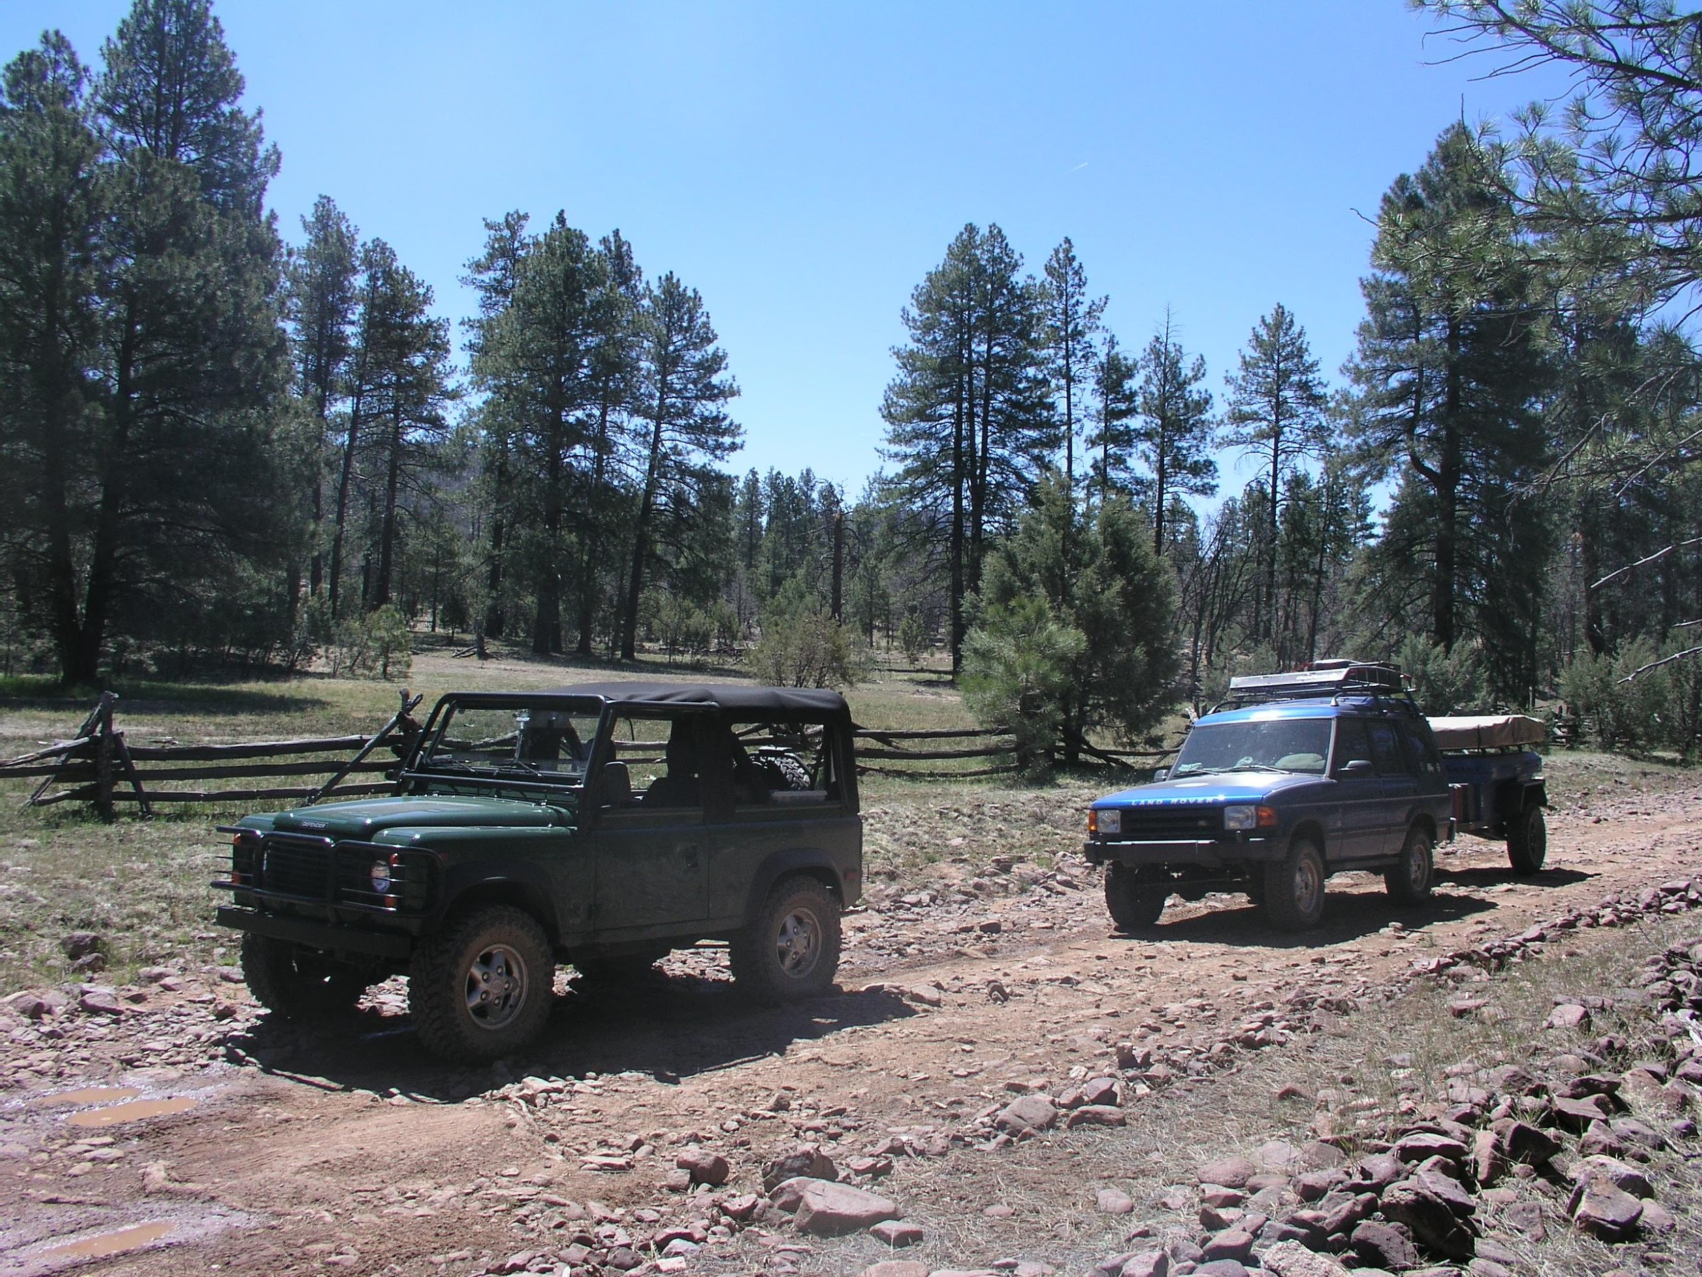
AGENDA – D7
2021 Supplemental Motorized Grant Applications
-Matt Eberhart, Off-Highway Vehicle Coordinator.

Slide 31
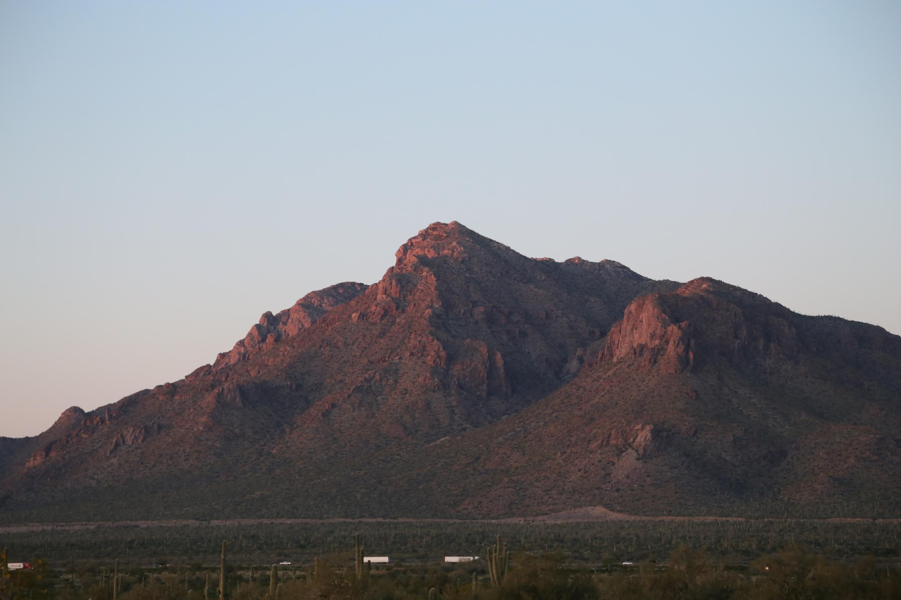
AGENDA – D7
2021 Supplemental Motorized Grant Application
Sponsor | Project | Request | Recommendations Staff/OHVAG/AORCC
Mohave County | Law Enforcement Equipment | $29,031.00 | $29,031.00
TOTAL |  | $29,031.00 | $29,031.00

Slide 32
AGENDA – D7
Motion:
I move to approve funding for the 2021 Motorized Grant Applications as follows: Mohave County, Law Enforcement Equipment in the amount of _______.

Slide 33
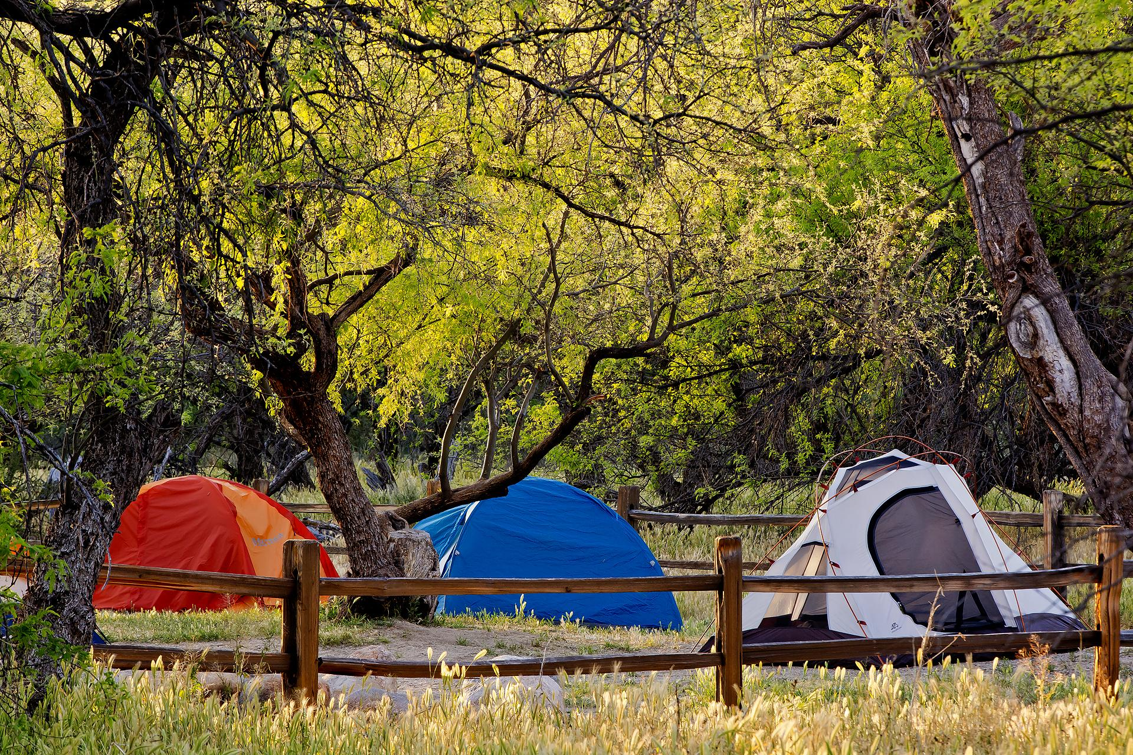
AGENDA – D8
Overview of Non-Motorized, Trail Maintenance, and Safety and Environmental Education Projects.
-Mickey Rogers, Chief of Grants and Trails.

Slide 34
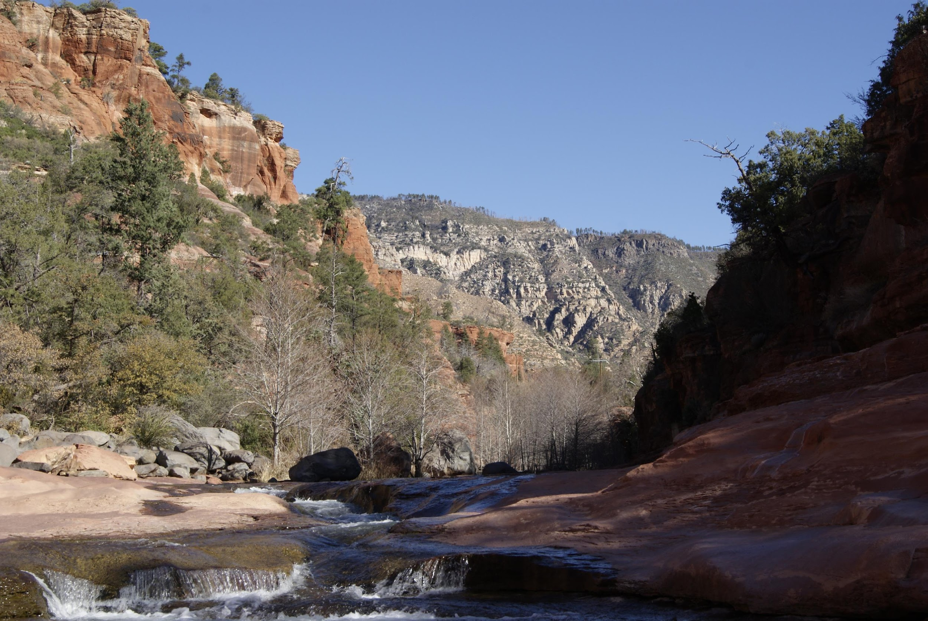
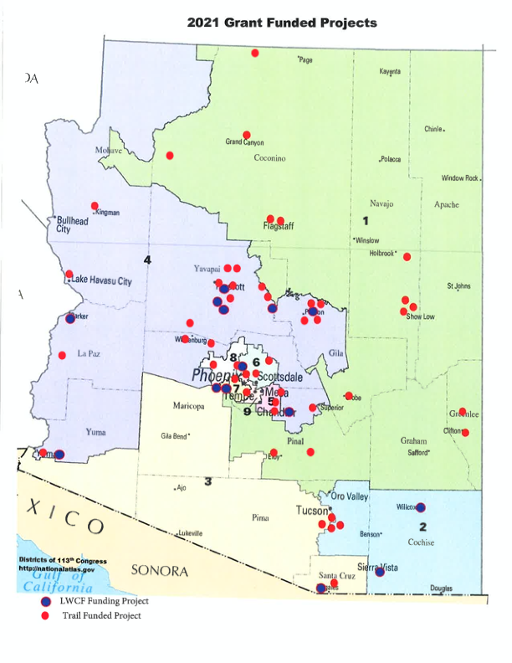
AGENDA – D8
Notes:
Non Motorized

Slide 35
AGENDA – D8
Project # | Sponsor | Project Title | Grant Award | Match | Total
Non-Motorized
472201 | Pinetop Lakeside | Mountain Meadows ADA Trail | $ 80,000.00 | $ 4,835.63 | $ 84,835.63
472202 | Granite Mountain Hotshot Memorial Park | Trail Improvement/Intern | $ 136,500.00 | $ 8,250.80 | $ 144,750.80
472203 | Lake Havasu State Park | Sunrise ADA Trail | $ 125,500.00 | $ 7,585.90 | $ 133,085.90
472204 | Show Low | ADA Meadow Trail Phase II | $ 133,952.00 | $ 8,096.78 | $ 142,048.78
472205 | Arizona Historical Society | Pioneer Museum Trail | $ 70,058.00 | $ 4,234.68 | $ 74,292.68
472206 | Verde Valley Archeological Center | Native American Heritage Trail Improvements | $ 150,000.00 | $ 9,066.81 | $ 159,066.81
 |  | Total | $ 696,010.00 | $ 20,672.32 | $ 716,682.32
Non-Motorized Diverse
472207 | Arizona Trail Association | Passage 21 Trail Maintenance | $ 48,000.00 | $ 2,901.38 | $ 50,901.38
472208 | Arizona Trail Association | Passage 4 Temporal Gulch | $ 149,990.00 | $ 9,066.20 | $ 159,056.20
472209 | Apache Junction | Silly Mountain | $ 82,000.00 | $ 4,956.52 | $ 86,956.52
472210 | Kingman | White Cliffs Wagon Wheel Phase II | $ 144,310.00 | $ 8,722.87 | $ 153,032.87
472211 | Scottsdale | McDowell Sonoran Preserve Trail | $ 47,300.00 | $ 2,859.07 | $ 50,159.07
472212 | Sierra Vista | Garden Canyon Trail | $ 150,000.00 | $ 9,066.81 | $ 159,066.81
 |  | Total | $ 621,600.00 | $ 37,572.85 | $ 659,172.85
Safety and Education
472216 | Flagstaff Trails Initiative | Etiquette and Stewardship Campaign | $9,065.00 | $ 547.94 | $ 9,612.94
472217 | Verde Valley Wheel Fun | Coordinator Position | $10,000.00 | $ 14,000.00 | $ 24,000.00
472218 | Apache-Sitgreaves National Forest | Volunteer Support Project | $9,996.00 | $ 604.21 | $ 10,600.21
472219 | Camp Verde | Urban Upland Trail Guide | $7,500.00 | $ 453.34 | $ 7,953.34
472220 | Verde Search and Rescue | Bike Unit Safety Training | $900.00 | $ 54.40 | $ 954.40
472221 | Verde Valley Cyclists Coalition | Trailhead Map Replacement | $10,000.00 | $ 604.45 | $ 10,604.45
472222 | Tucson Audubon Society | Cuckoo Corridor Trail Signage | $3,185.00 | $ 192.52 | $ 3,377.52
472223 | Legends of Superior Trails | LOST Trailer, Tools and Training | $7,498.00 | $ 453.22 | $ 7,951.22
 |  | Total | $58,144.00 | $16,456.86 | $ 74,600.86
Notes:
Non Motorized

Slide 36
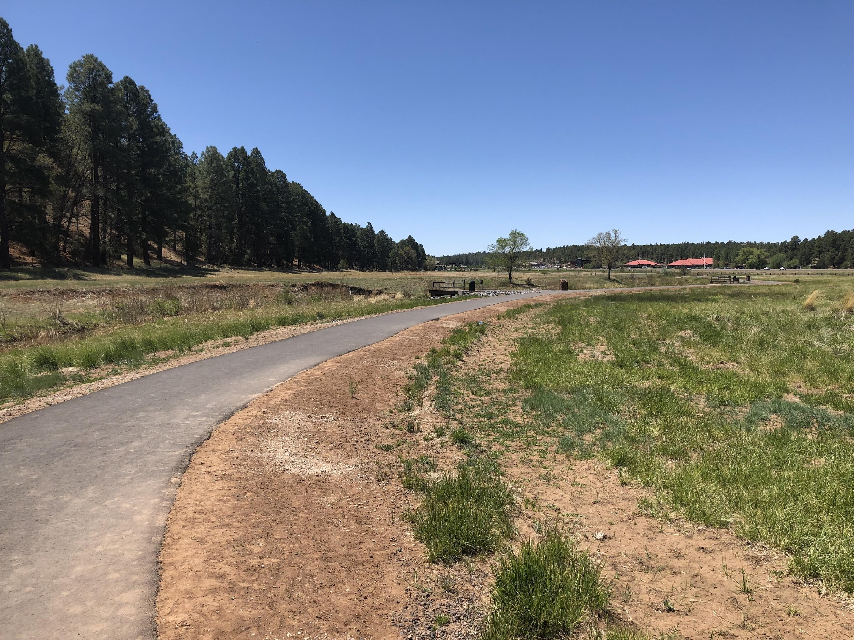
AGENDA – D8
Notes:
Miles of new Trail

Slide 37
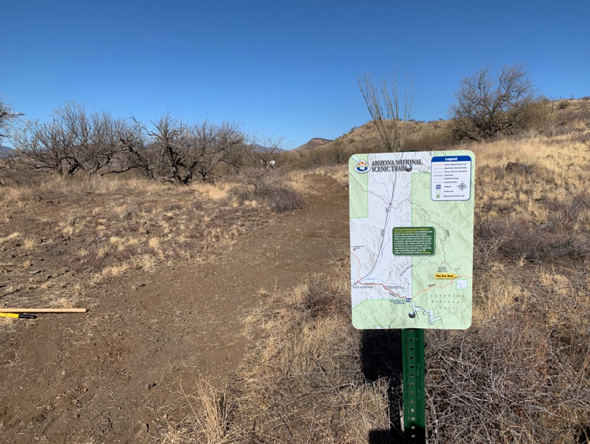
AGENDA – D8
Notes:
Miles of new Trail

Slide 38
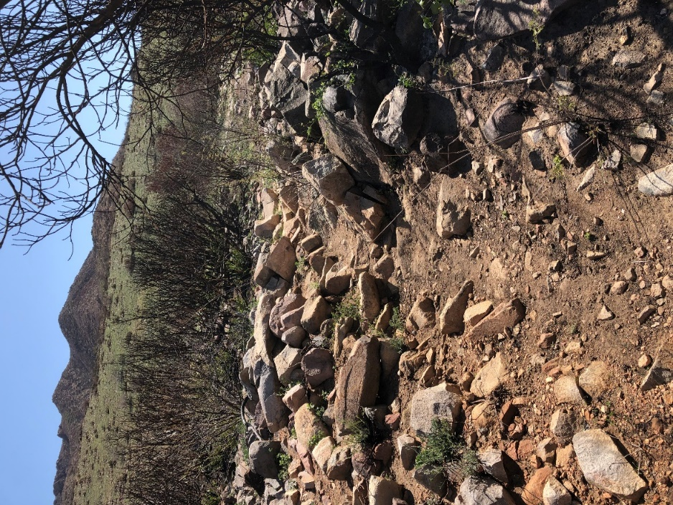
AGENDA – D8
Notes:
Miles of new Trail

Slide 39
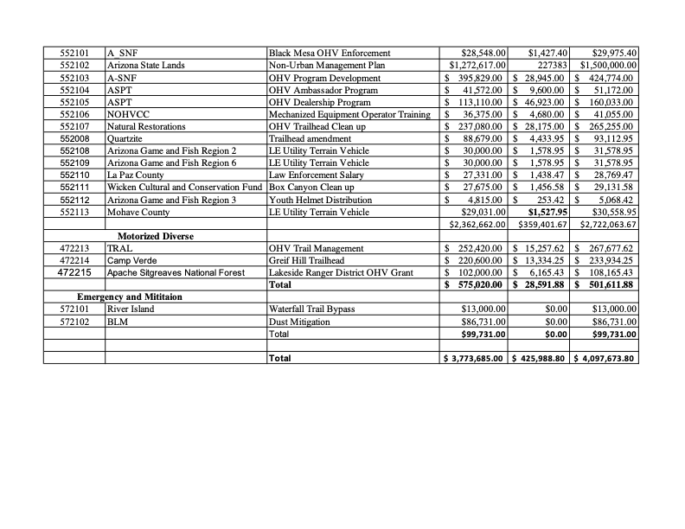
AGENDA – D8
Notes:
Motorized

Slide 40
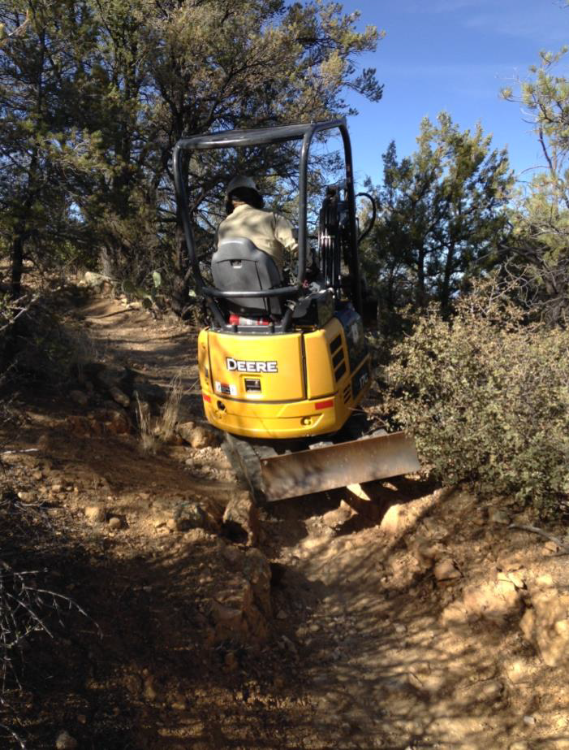
AGENDA – D8
Notes:
Miles of New/rehabbed trails

Slide 41
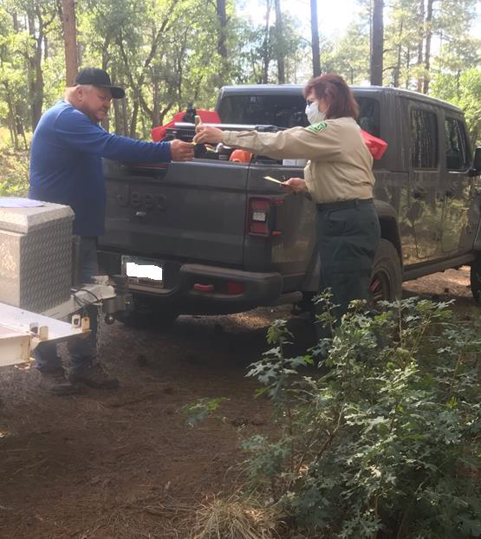
AGENDA – D8
Notes:
Staff/LE positiions

Slide 42
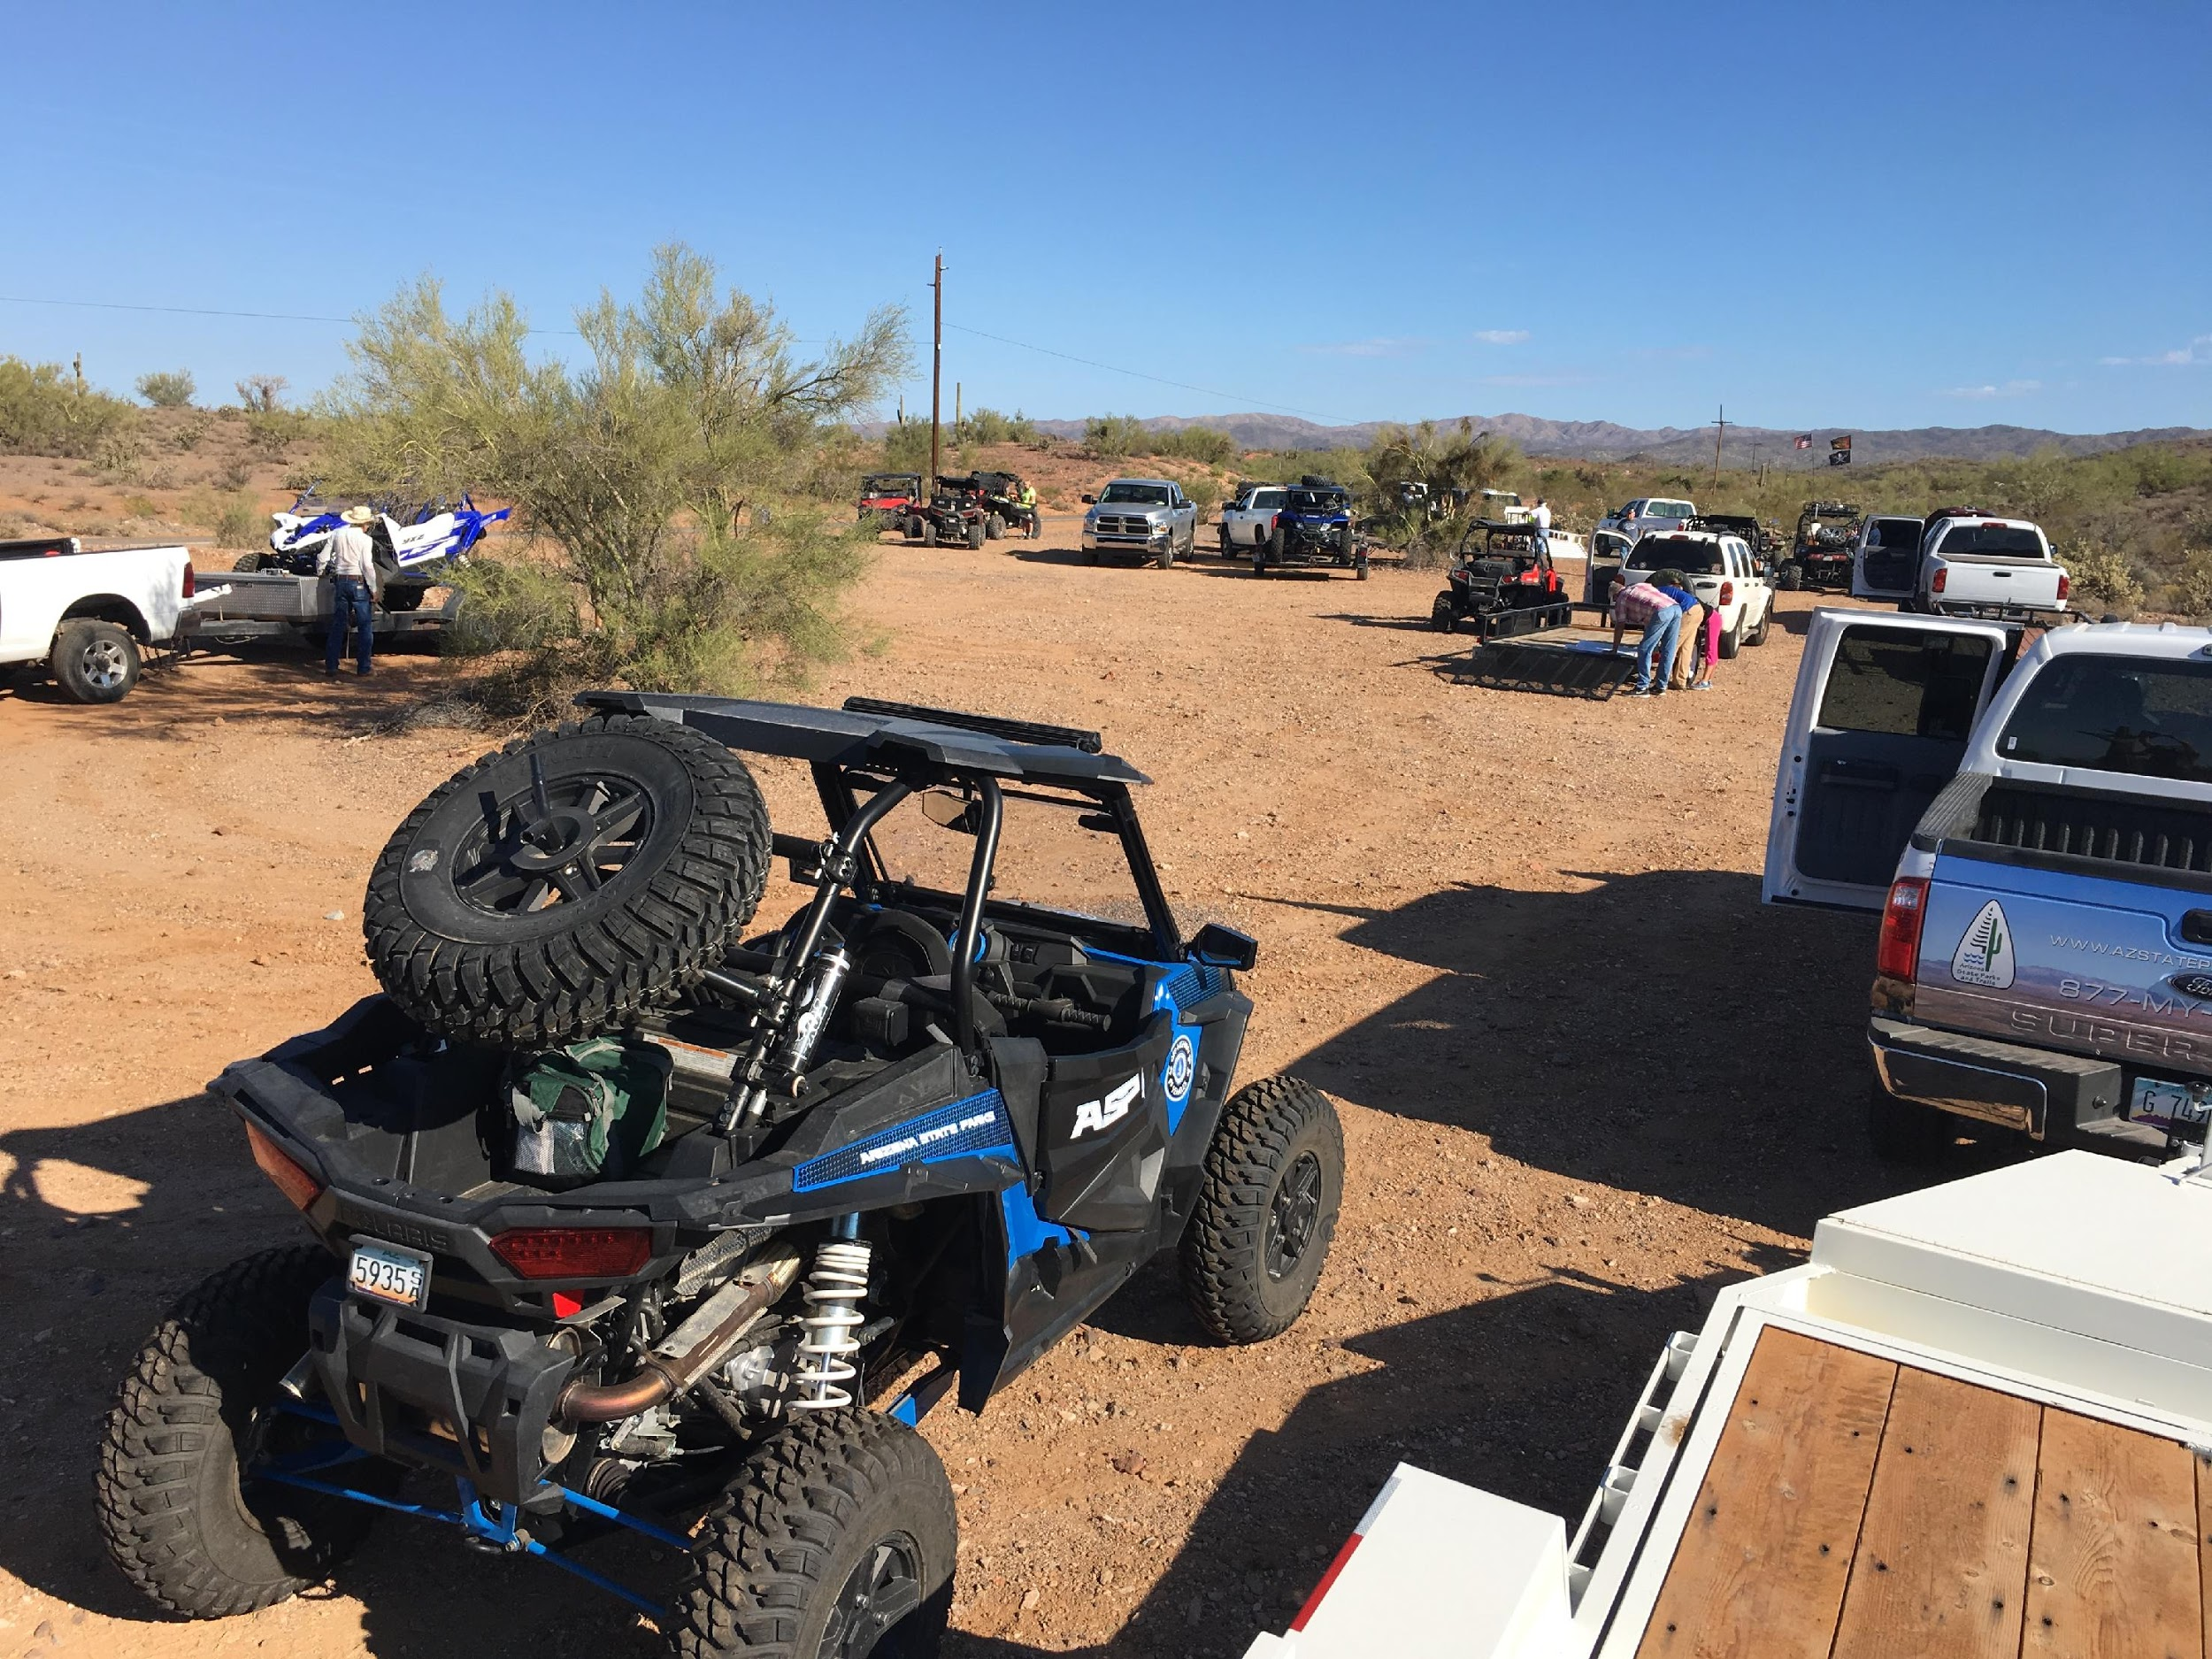
AGENDA – D8
Notes:
Staff/LE positiions

Slide 43
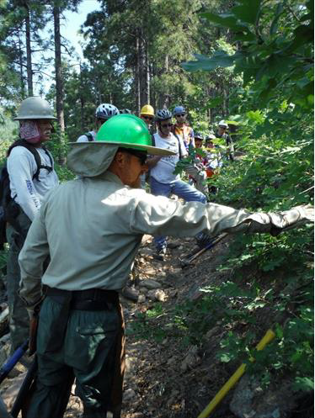
AGENDA – D8
Notes:
Put in volunteer hours

Slide 44
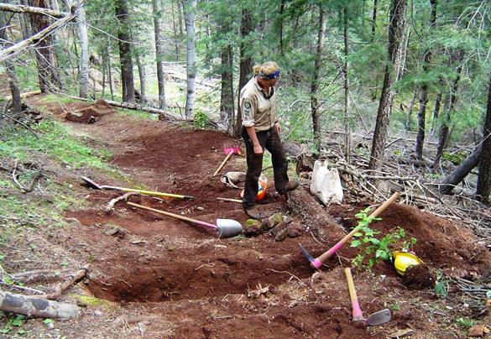
AGENDA – D8
Notes:
Put in weeks of Americorp

Slide 45
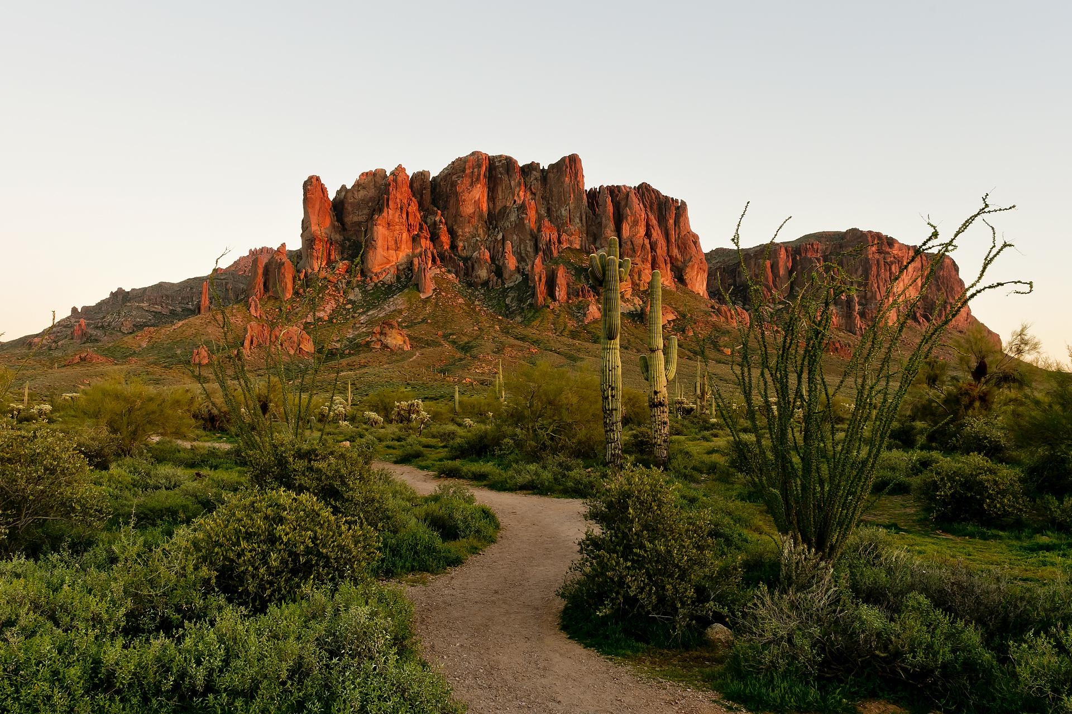
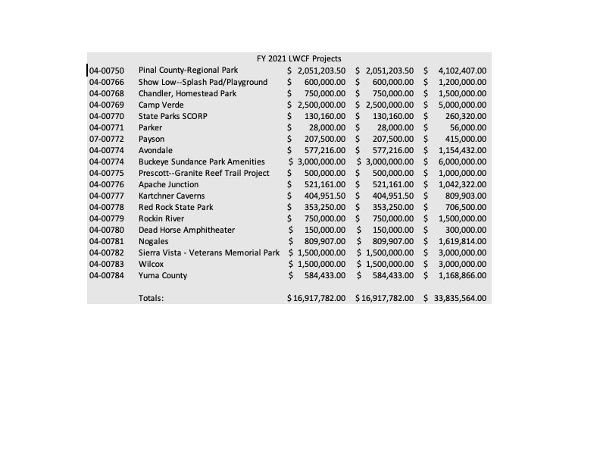
AGENDA – D8
Notes:
LWCF

Slide 46
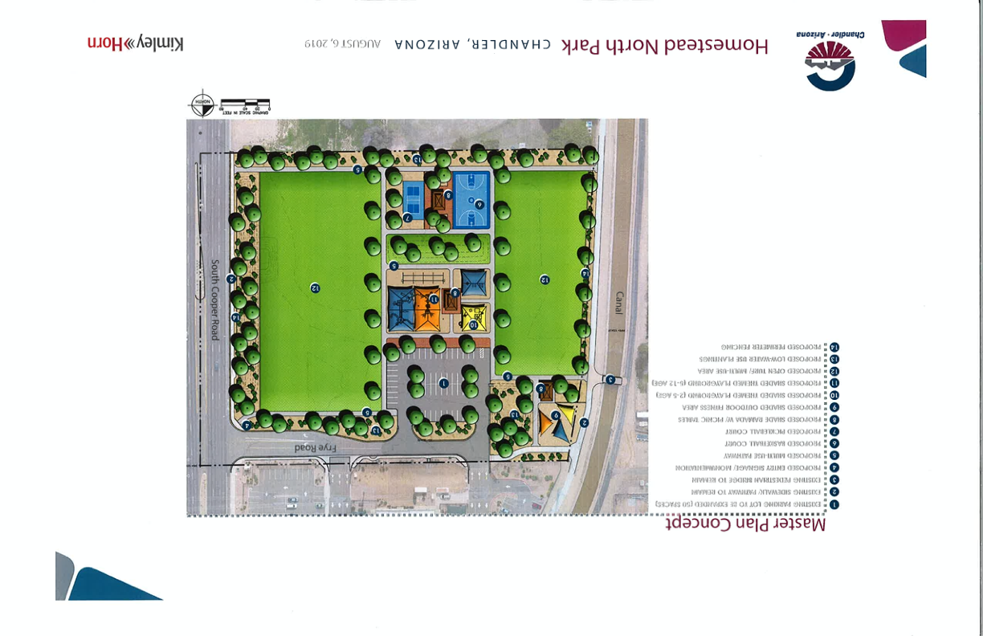
AGENDA – D8
Notes:
LWCF—4 New parks

Slide 47
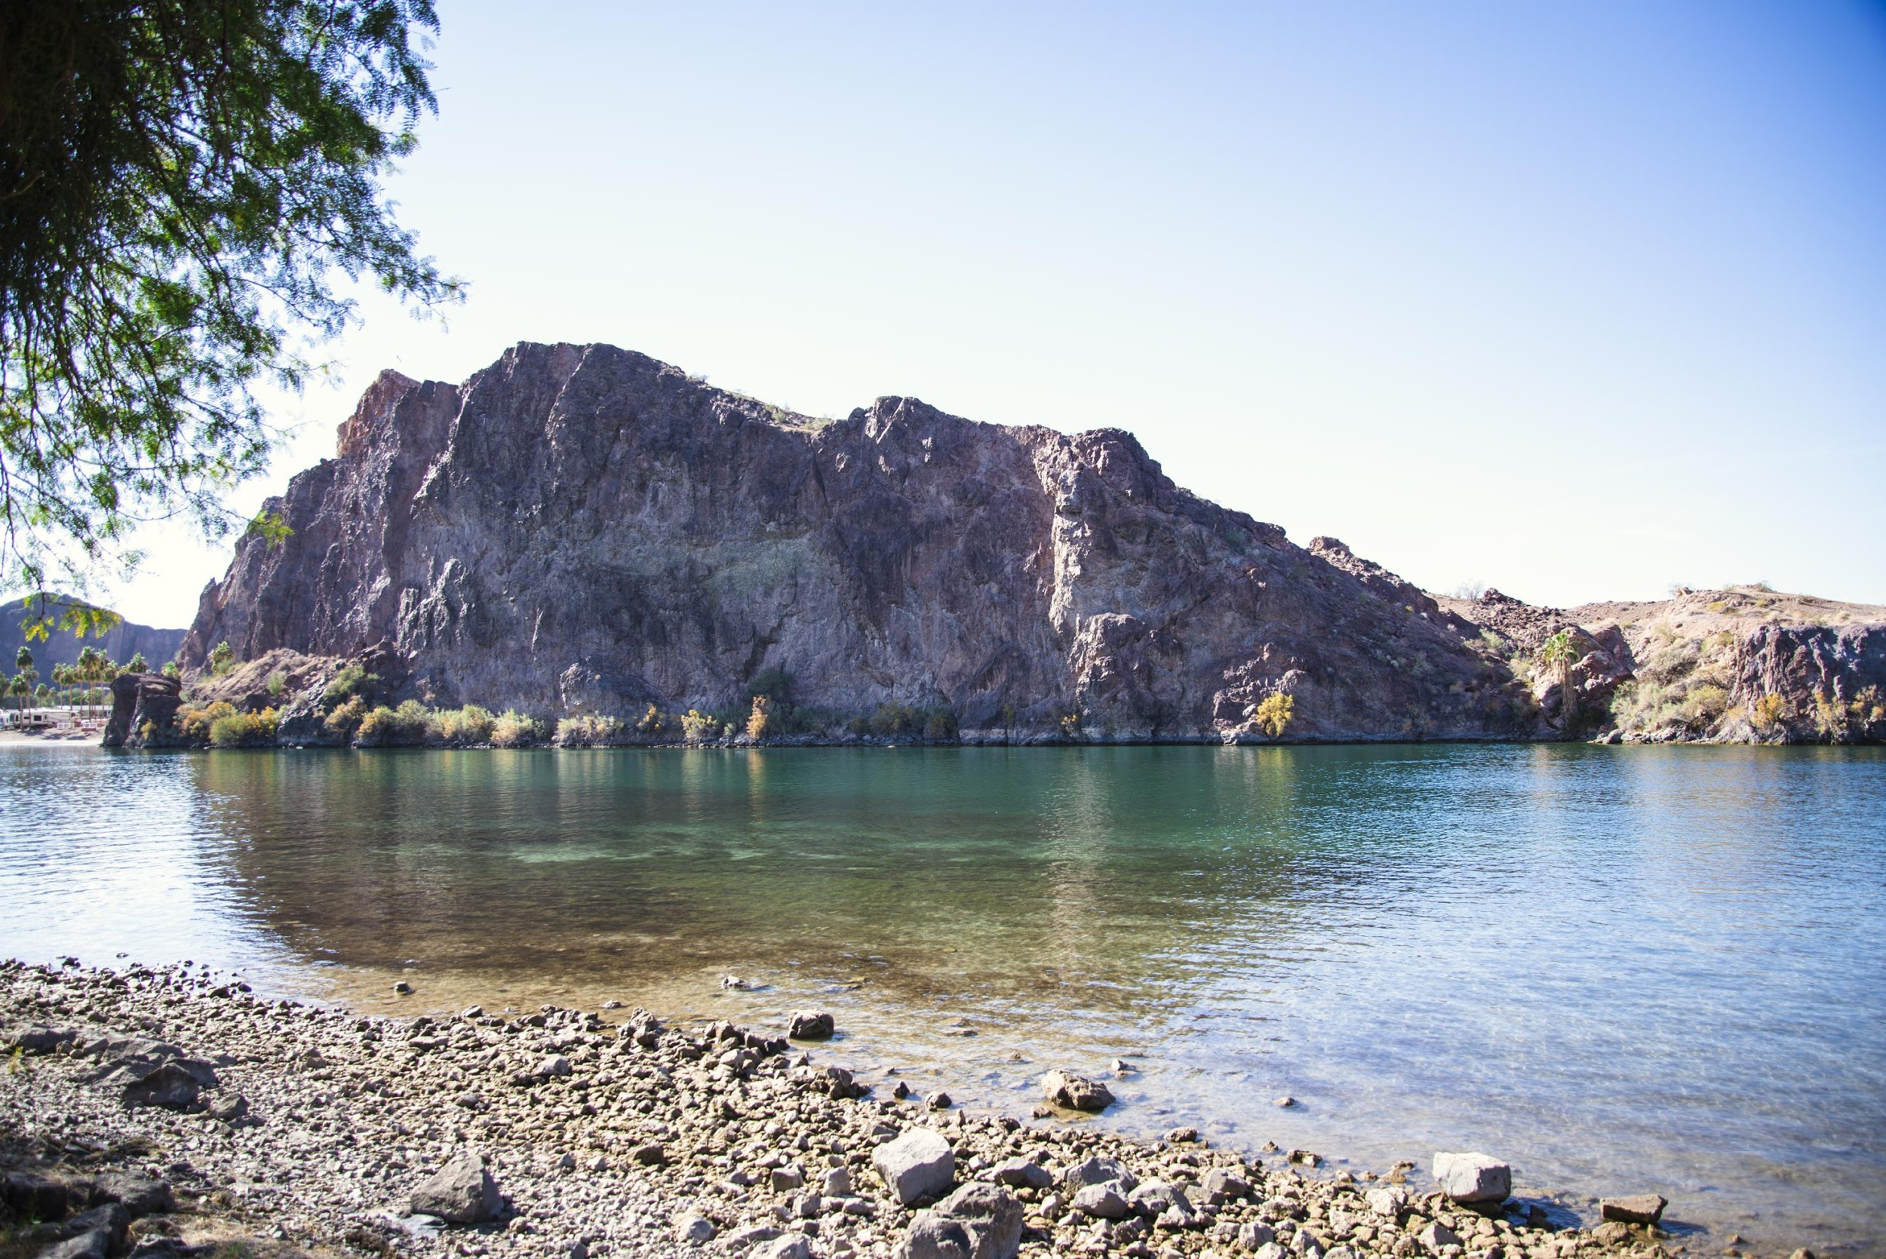
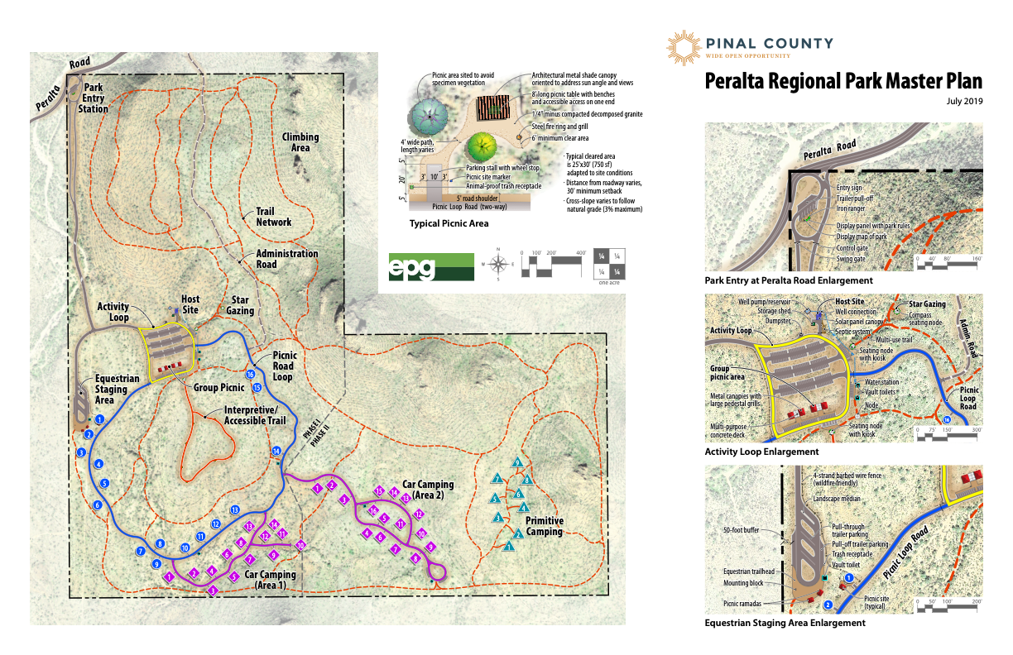
AGENDA – D8

Slide 48
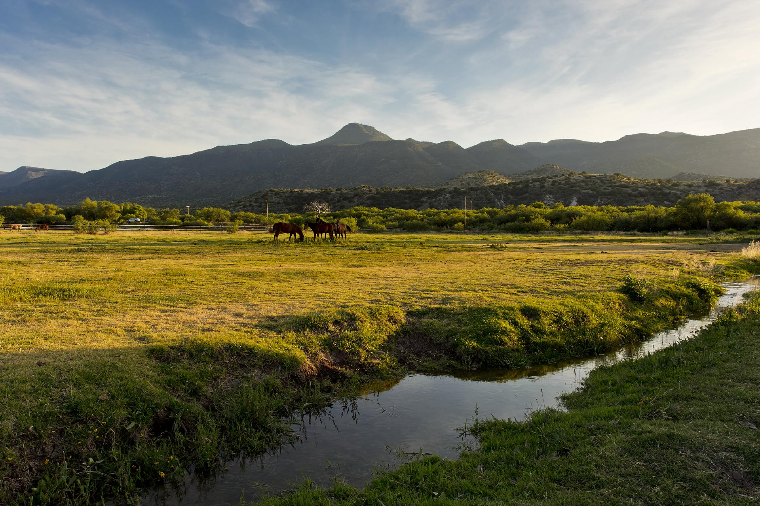
AGENDA – D8

Slide 49

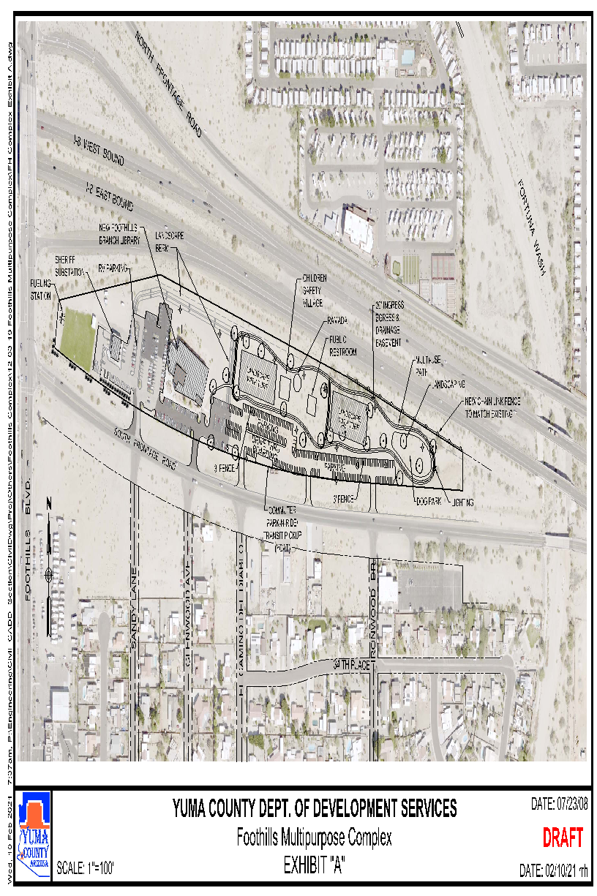
AGENDA – D8

Slide 50
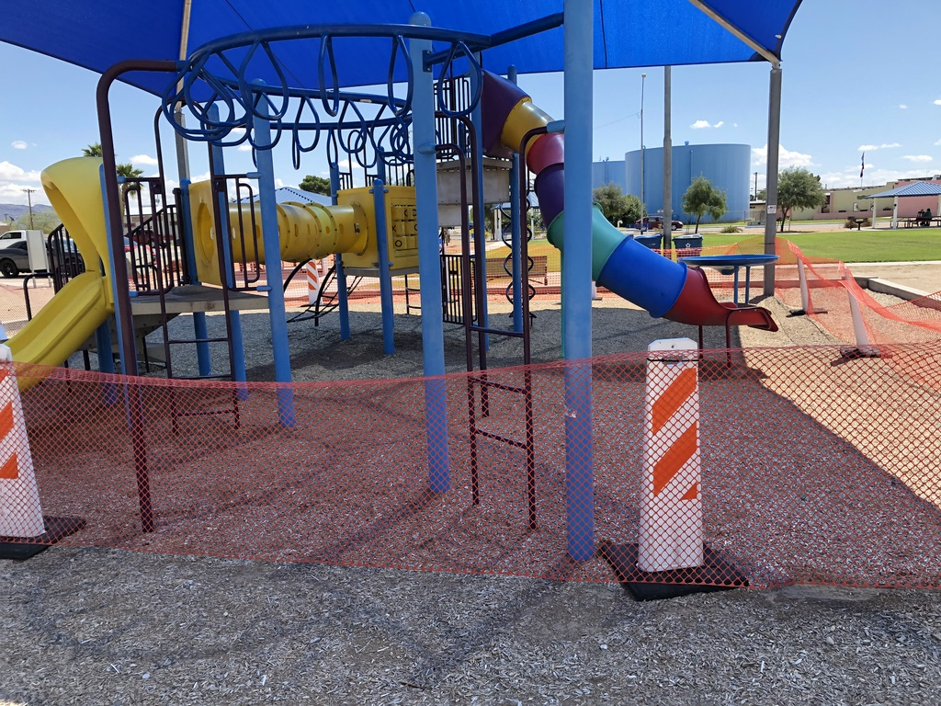
AGENDA – D8
Notes:
4 Playgrounds

Slide 51
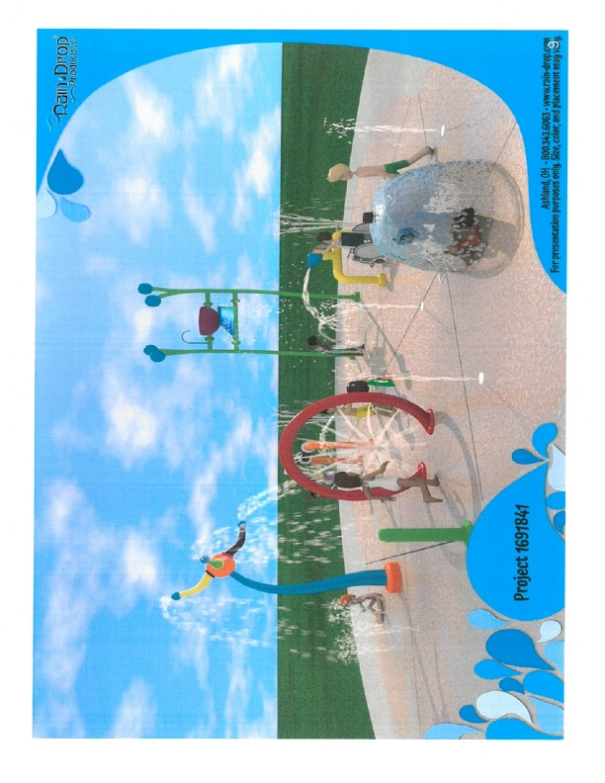
AGENDA – D8
Notes:
2 Splash Pads

Slide 52
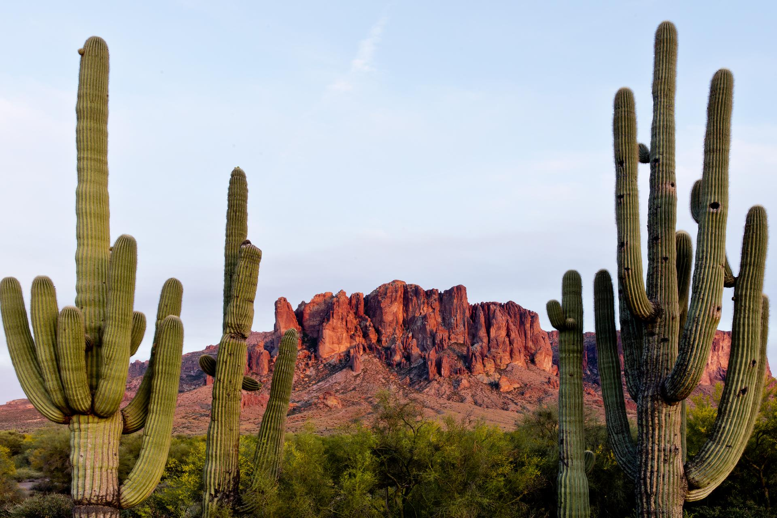

AGENDA – D8
Notes:
Statewide Plans—two funded with motorized, NULP and GWT

Slide 53
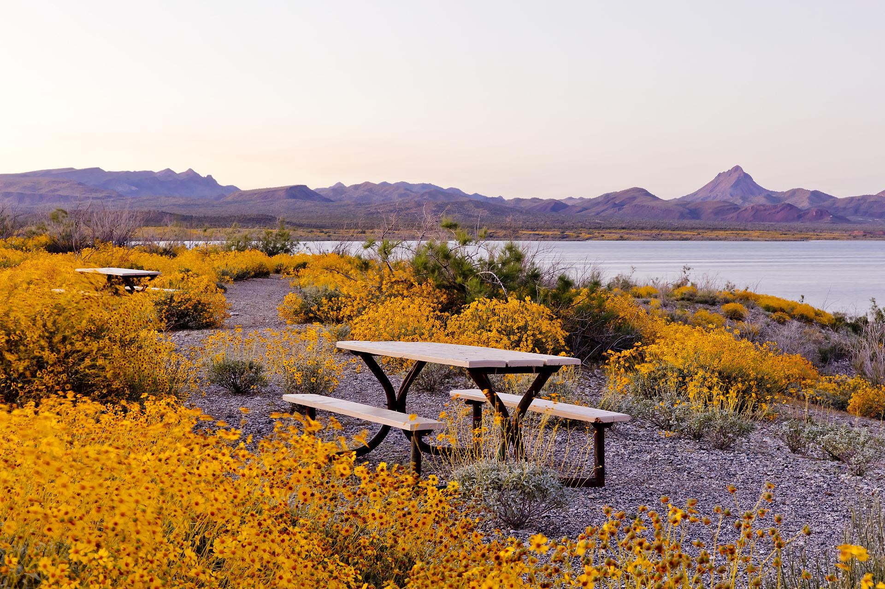
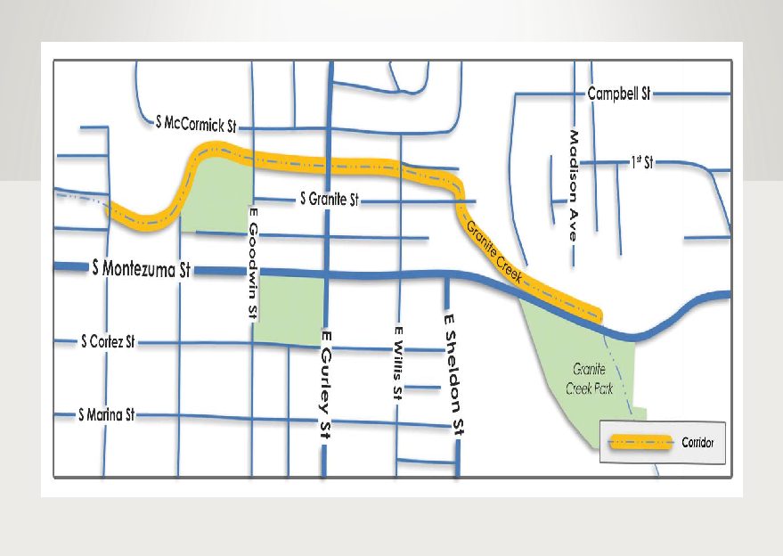
AGENDA – D8
Notes:
1 Trail Project

Slide 54
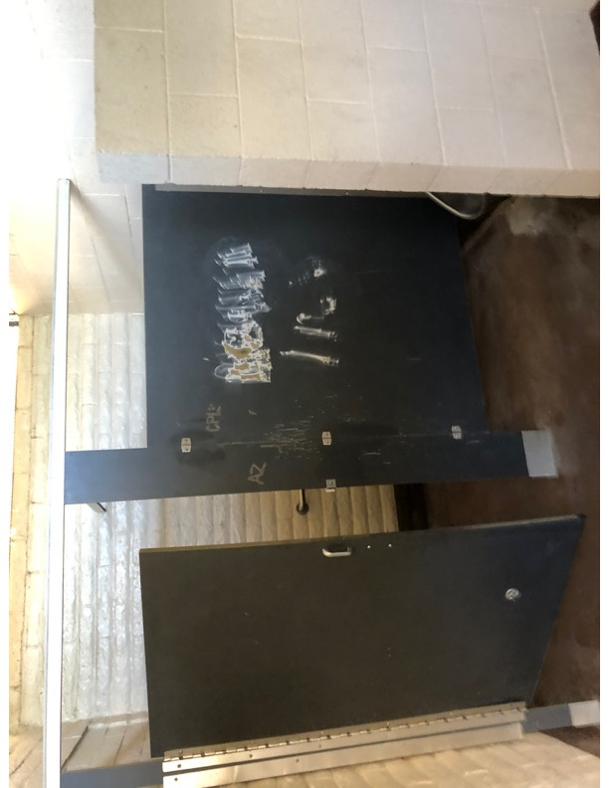
AGENDA – D8
Notes:
11 Park improvement/expansion Project

Slide 55
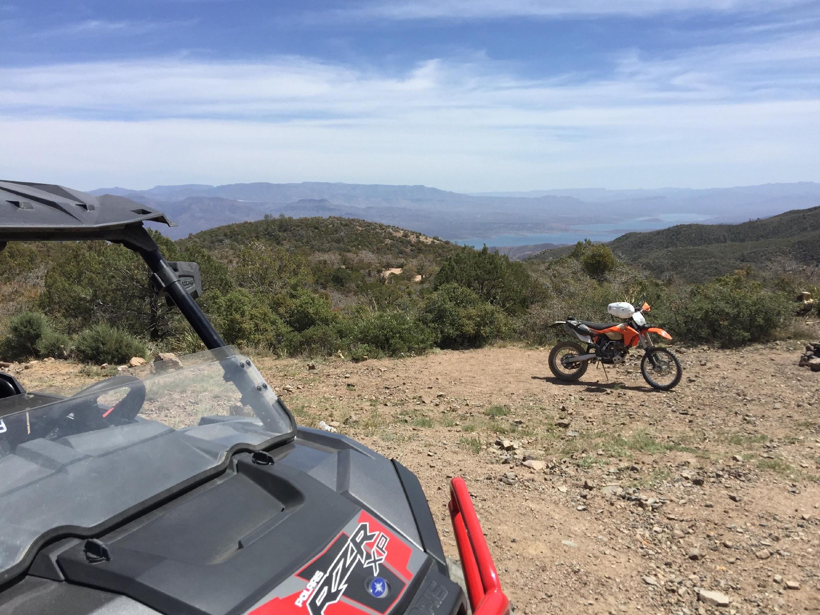
AGENDA – D9
Bureau of Land Management Emergency and Mitigation Update
-Matt Eberhart, Off-Highway Vehicle Coordinator.

Slide 56

AGENDA – D9

Slide 57

AGENDA – D9

Slide 58

AGENDA – D10
The Coalition for Recreational Trails (CRT) Annual Achievement Awards
-Jeff Schmidt, GIS/Intern Coordinator .

Slide 59

AGENDA – D10
Maintenance and Rehabilitation – maintaining, repairing damage to, or upgrading the quality of a trail to improve the trail experience, increase user safety, and/or enhance protection of the environment, including wildlife.
Construction and Design – planning and building a trail, portions of a trail (e.g., a bridge), or trail-related facilities (e.g., a trailhead, shelter, etc.).
Public-Private Partnerships and Access to/Use of Public Lands – facilitating and/or encouraging cost-effective partnerships between public and private entities, especially to increase access to and use of federal, state and local public lands, including parks, forests and wildlife refuges.
Community Linkage – providing and/or enhancing opportunities for trail-based recreation and transportation within or near local communities.
Education and Communication – utilizing a variety of established and/or technologically innovative communications tools (e.g., web sites, social media and peer-to-peer information sharing) to increase environmental awareness, promote trail-related safety, encourage trail-related outdoor recreation and, overall, enhance trail use and enjoyment.
Multiple-Use Management and Corridor Sharing – facilitating and/or encouraging the use of a trail corridor by more than one type of trail enthusiast, particularly those enthusiasts that do not ordinarily share trails or trail-related facilities.
Accessibility Enhancement – facilitating and/or encouraging increased access to trail-related recreation opportunities for people with disabilities.
Youth Conservation/Service Corps and Community Outreach – making effective use of the services and skills of qualified youth conservation or service corps and other community organizations as project partners and supporters.
Engaging Public-Sector Partners – engaging and garnering the support of public-sector officials including local, state and federal elected officials or agency personnel for RTP-funded projects or the overall continuation/advancement of the RTP.
Enhancement of Federal Lands – planning and building a trail or maintaining and rehabilitating a trail on federally managed lands to enhance the public use and enjoyment of those lands.

Slide 60

AGENDA – D11
Legislative Update.
-Brittany Hudson, Legislative and Tribal Liaison.

Slide 61

AGENDA – E
Future Agenda Items
Board members may identify items or issues they wish to be considered for inclusion on a future Board agenda. The Board may vote to take action on or provide the agency direction on this agenda item.

Slide 62

AGENDA – F
Executive Director’s Report on Current Events
The Executive Director may discuss current events
and/or recent experiences of interest to the
outdoor recreation community and/or the
status of any projects with which they are
currently involved.

Slide 63

AGENDA – G
Current Events
Board members will discuss current events and/or recent experiences of interest to the outdoor recreation community and/or the status of any projects with which they are currently involved.

Slide 64

AGENDA – H
Call to the Public
The chair will recognize those wishing to address the Board.

Slide 65
AGENDA – I
Future Meeting Dates
Arizona State Parks & Trails 2021 Board Meeting Schedule
Date | Location
Thursday, August 19, 2021 | Central Office
Thursday, September 16, 2021 | Central Office
Thursday, October 21, 2021 | Central Office
Thursday, November 18, 2021 | Central Office
Thursday, December 16, 2021 | Central Office

Slide 66
THANK YOU!

